Slide 1
CS/EE/ME 75(a)
Nov. 5, 2018
Today:
        Requirements/Specifications
        Generate/Evaluate Alternatives
        Homework

Slide 2
Structured Design Method(s)
Recognition of a Need
Clarification of Objectives
Establish Function
Set Requirements
Problem Definition
Generate Alternatives
Evaluate Alternatives
Create Details
Solution Generation
Analysis & Optimization
Prototyping

Slide 3
Structured Design Method(s)
Recognition of a Need
Clarification of Objectives
  Objective Tree
  GOTChA chart
Establish Function
Function Diagrams
System Architecture
Set Requirements
Specifications
Problem Definition
Solution Generation
Analysis & Optimization
Prototyping

Slide 4
Specifications/Requirements
                Specification = “to state explicitly, or in detail”
                Describe what component should be, not how to build it.
                Common types of specifications:
                Functional Performance: speed, power, energy capacity,
                Operating conditions: temp., humidity, pressure
                Physical Attributes: mass, volume, max dimension
                Reliability: Safety, MTBF
                Life-cycle: maintenance, repair,
                Constraints: cost, time to completion, standards
                Manufacturing Issues: materials, processes, quantity
                Human Factors: complexity of interface, user operation

Slide 5
Specifications/Requirements
Why?
                Communicate between design/development teams.
                Limit frequent system changes and design updates.
                Avoid lack of compatibility in subsystems
                How?
                Identify the stakeholders of your design/subsystem
                Who will use your system?
                What teams (design, develop, test, field) will be affected by your subsystem?
                Who will maintain your system?
                Who else will be affected by your system? (e.g., DARPA clean-up crews)
            Requirements: that must be satisfied by subsystem
            Specifications: quantify the limits or performance of your subsystem

Slide 8
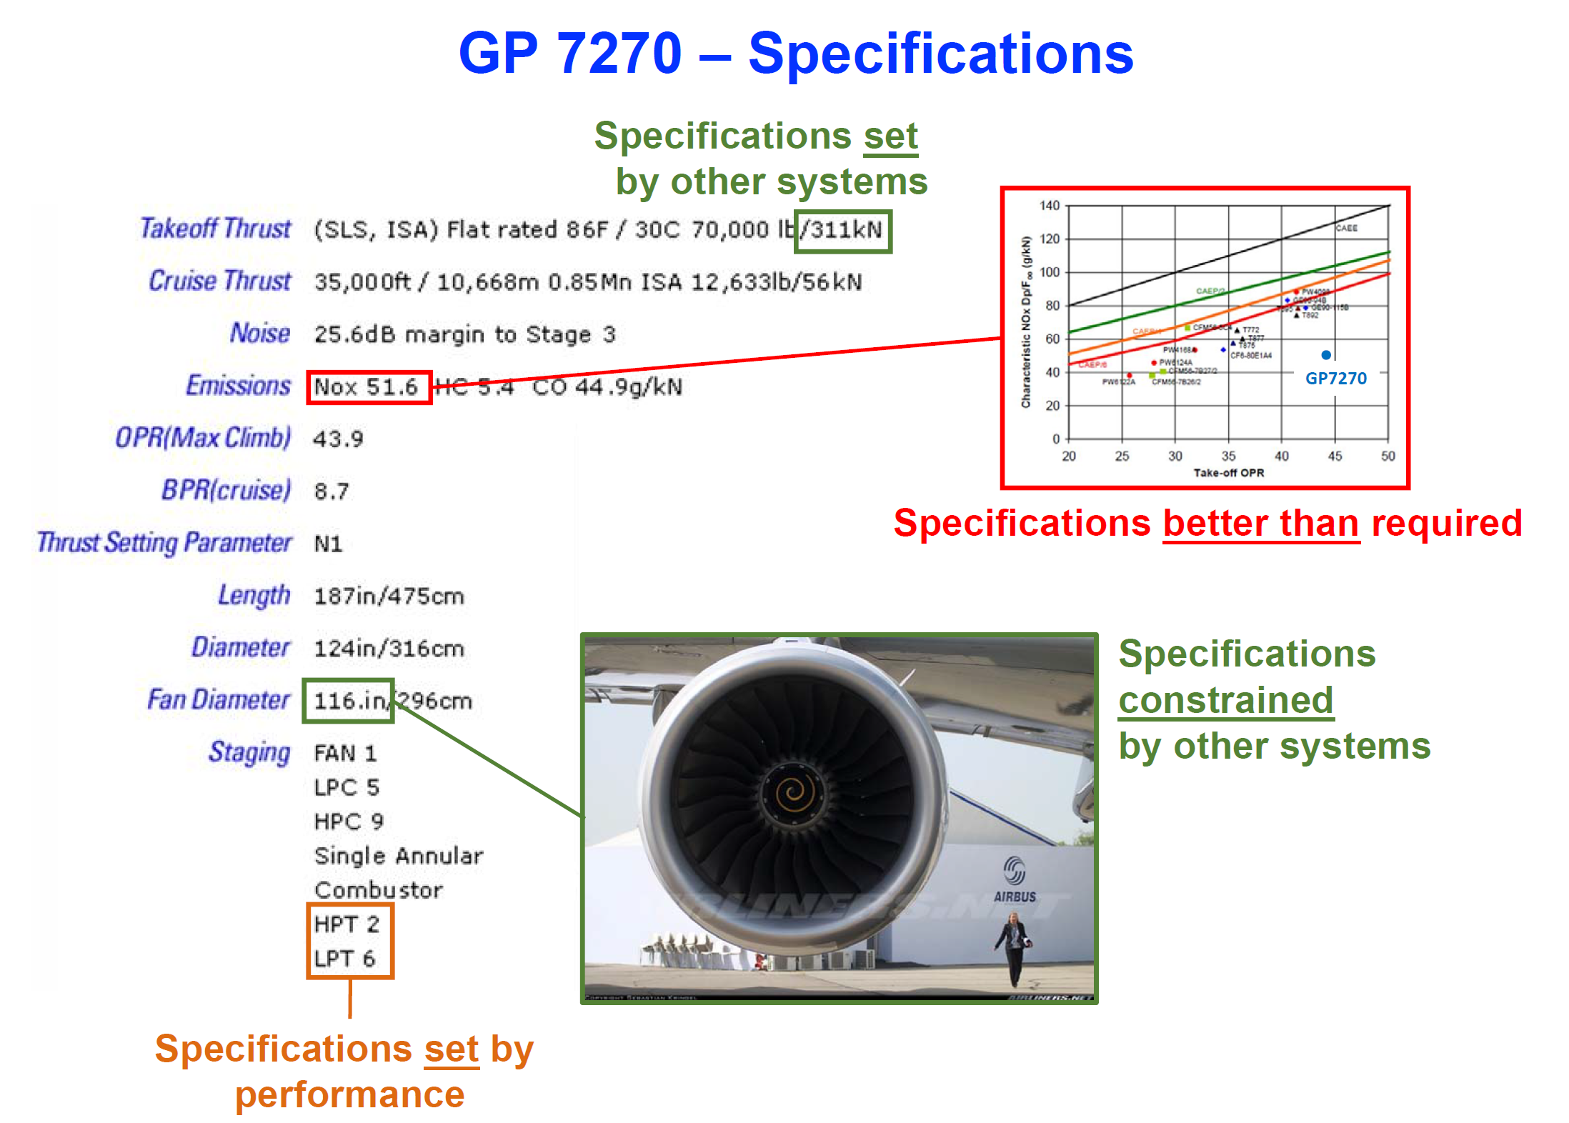

Slide 9
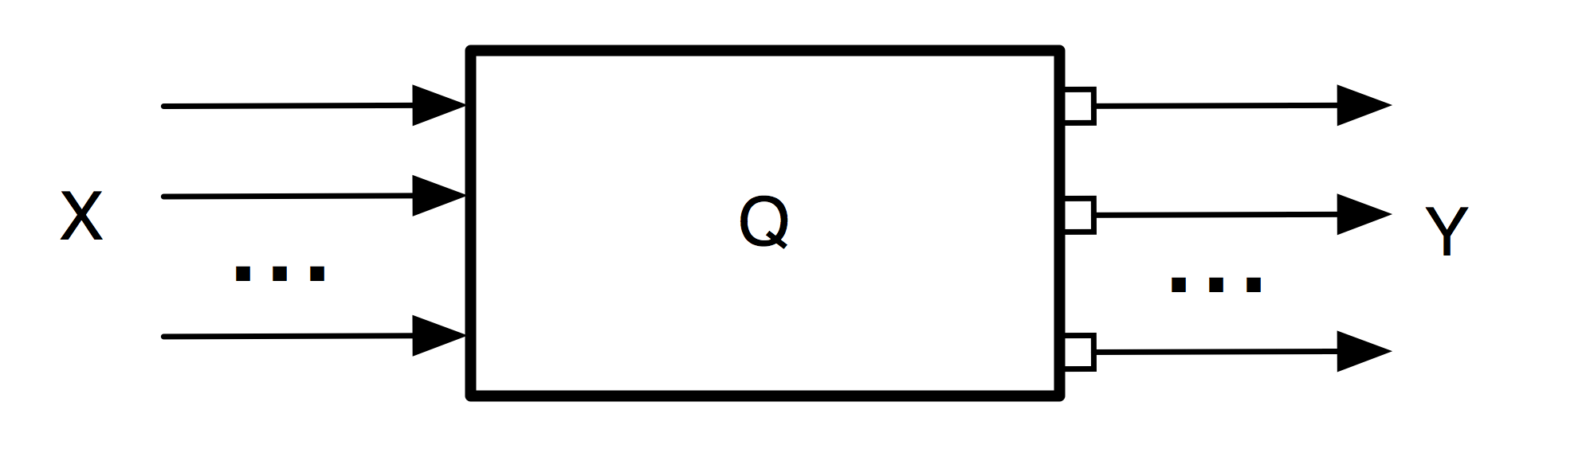
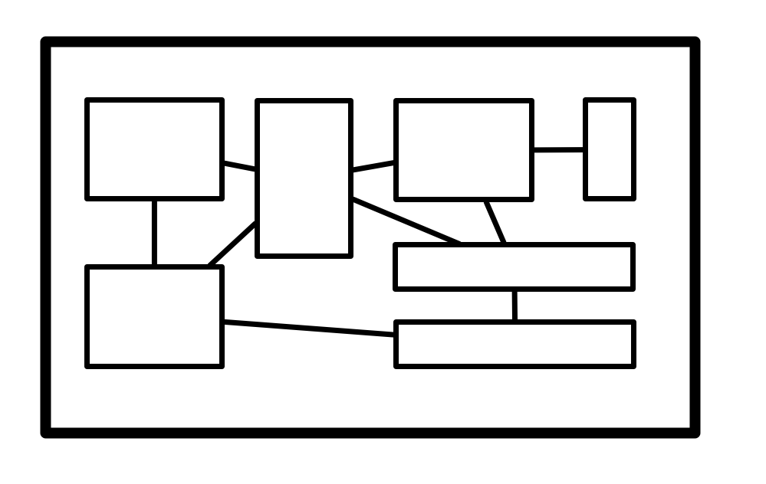
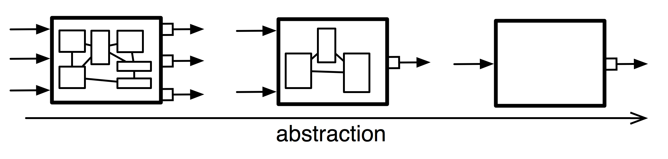
System Architecture
Requirements for an Architecture:
  The objects/elements of the system can be modeled (possibly as their own systems)
  System can be broken down into small systems (hierarchy)
    Can be considered at various levels of abstraction

Slide 10
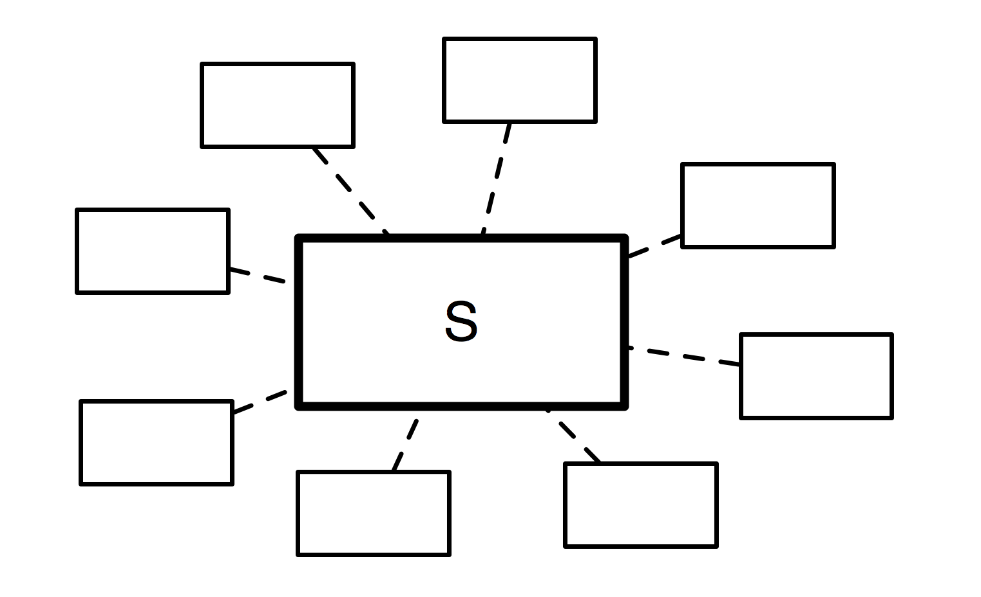
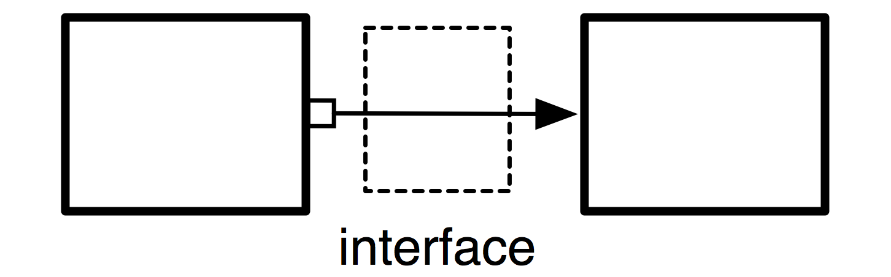
System Architecture
  Interactions with environment and other systems
  Interfaces between components
  Socio-Technical Aspects
  Behaviors and Dynamics of the various elements
  Multiple Views of the system (from energy usage, information usage

Slide 11
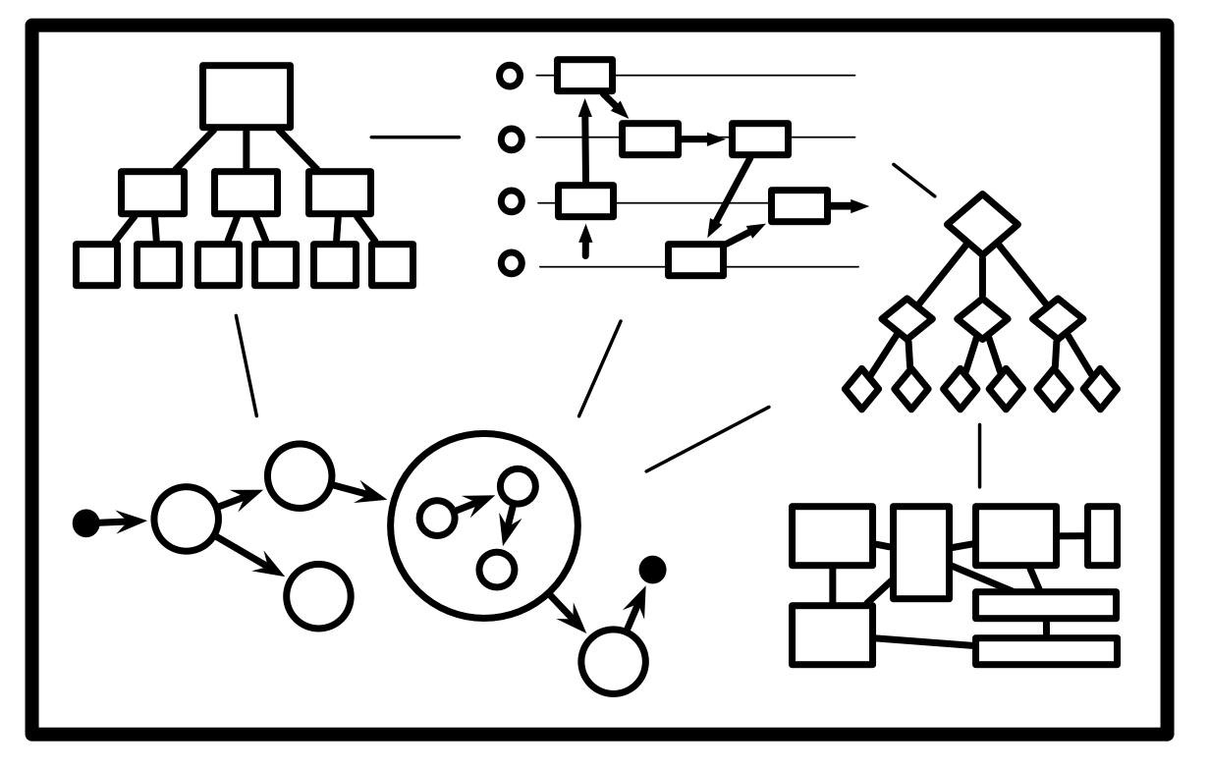
System Architecture
  Multiple Views of the system (from energy usage, information usage

Slide 13
Structured Design Method(s)
Recognition of a Need
Clarification of Objectives
Establish Function
Set Requirements
Problem Definition
Generate Alternatives
Evaluate Alternatives
Create Details
Solution Generation
Analysis & Optimization
Prototyping

Slide 14
Generate Solutions
              Goal:
                Create as many distinct solutions as possible.
                Create many possible alternative rearrangement of components
                Organize alternatives for future evaluations
                Classify alternatives
            Morphology Chart (best for electromechanical design problems):
                Required functions/features along rows
                Different design alternatives and combinations along rows.
                Phrases or sketches to capture the concept
            Sometimes other alternatives, such as concept diagrams or classification trees, are better suited to a given problem

Slide 15
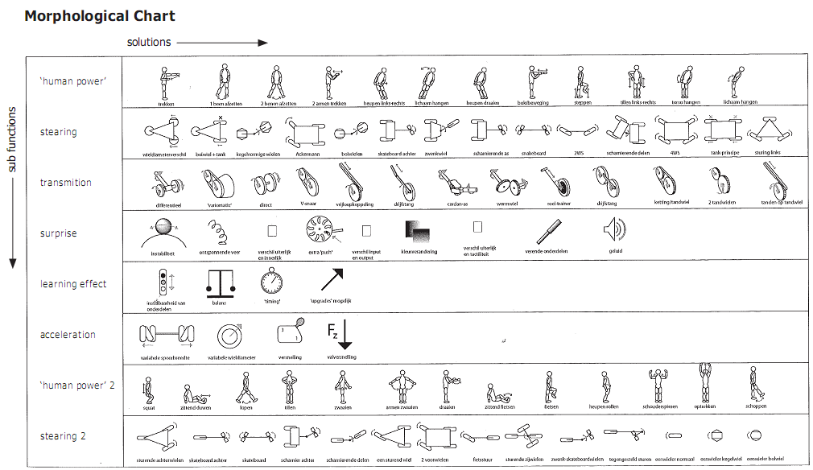

Slide 18
Homework
Develop a Team GOTChA chart for your team’s project.
Structured Design Artifacts
Objective Tree
List of Requirements & Specifications
Morphology Chart for solution

Slide 19
GOTChA Charts
(for developers and managers)
GOTChA :
                Goals
                Objectives
                Technical Challenges
                Approach
                Use a Quad Chart structure
Goals: high level description of main goal(s) and desired results of the project/effort
Technical Challenges: list expected difficulties
Challenge 1
Challenge 2
Challenge 3
Objectives: list of objectives required to meet goal
Obj. 1: <obj > < date >
Obj. 2: <obj> < date >
Approach: list of proposed methods to realize goals/objectives
Act. 1: < build a model >
Act. 2: < simulate the model >
Act. 3: < design experiment

