Slide 1
CS/EE/ME 75(a)
Oct. 21, 2018
Today:
SubT Review
Architecture: Physical, Software
Management: Team structure
Tentative Schedule:
First Look at Projects

Slide 2
CoSTAR-bots: Collaborative SubTerranean Autonomous Resilient Robots to Explore Subterranean Environments
NASA’s JPL
California Institute of Technology
Massachusetts Institute of Technology
POC: Dr. Ali Agha (PI)
POC: Dr. Joel Burdick
POC: Dr. Luca Carlone
DARPA Subterranean Challenge, September briefing, Sep. 20th, 2018
© 2018 Caltech. All rights reserved.

Slide 3
Final event

Slide 4
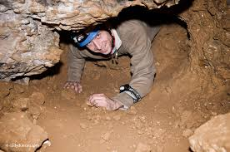
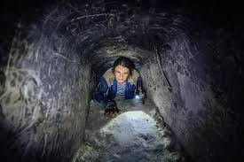
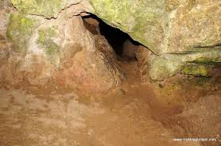
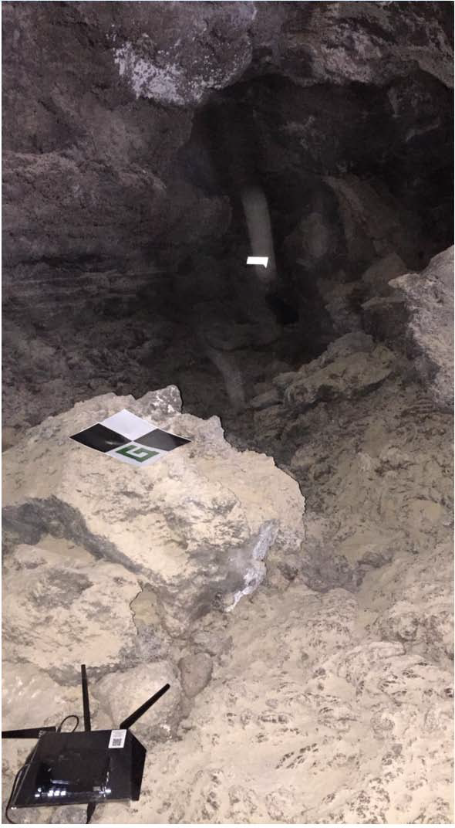
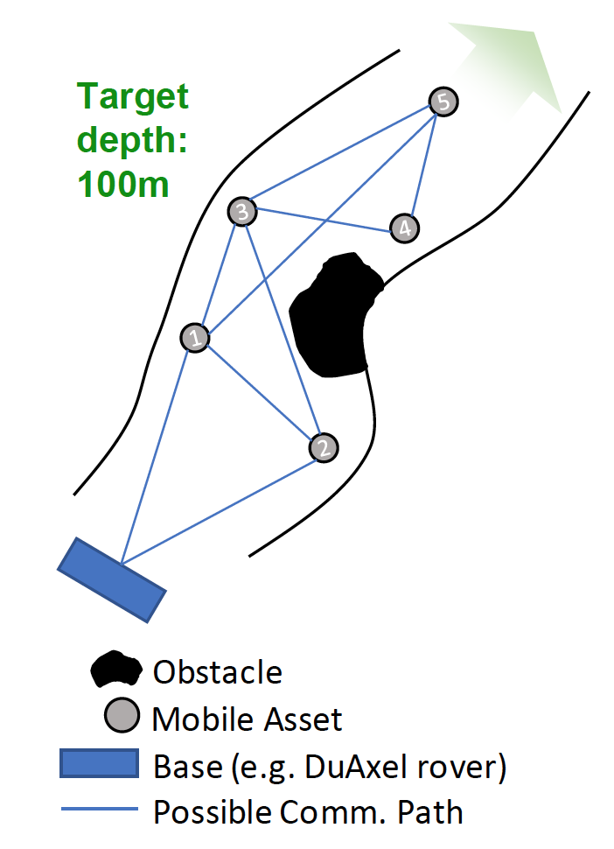
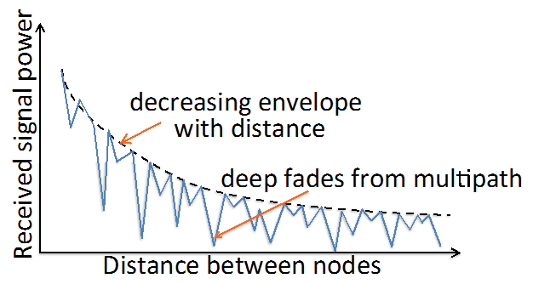
General Challenges in SubT Environments
Mobility
Narrow passages
Climbs and drops
Unpredictable terrain
Dust, debris
Perception
Bandwidth constraints
Darkness/energy constraints
Dust/debris
Perceptual aliasing and high outlier rate
Automated or human-guided recognition?
Localization
No GPS underground
Limited communication between vehicles
Multi-vehicle aspect.

Slide 5
General Challenges in SubT Environments
Communication
Latency constraints
Requires daisy-chain operation
Multipath environment can generate unpredictable link qualities
Rock/soil is poor transmission medium
Need to model, validate, and mitigate uncertainties in data links between nodes in SubT environment
Data drop out

Slide 6
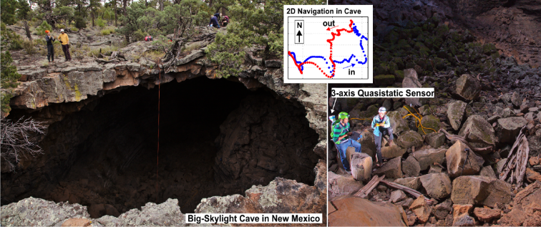
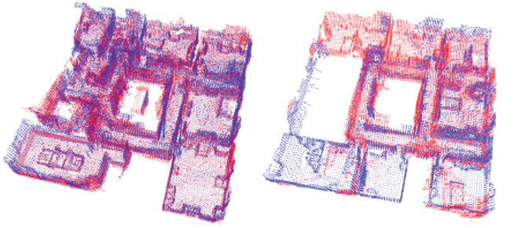
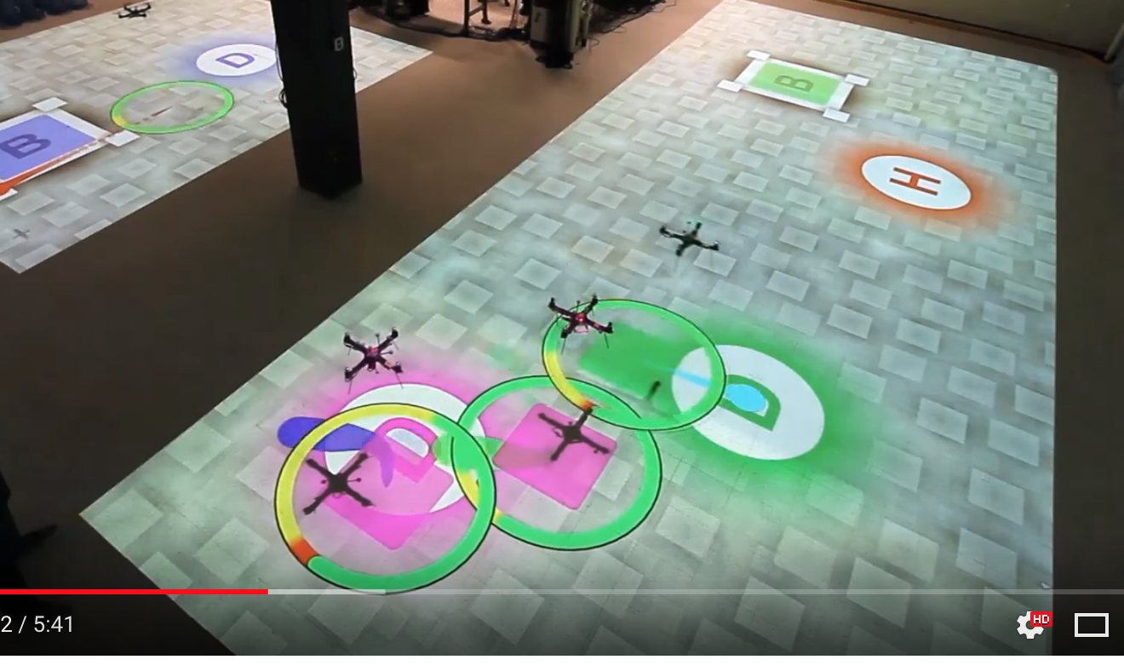
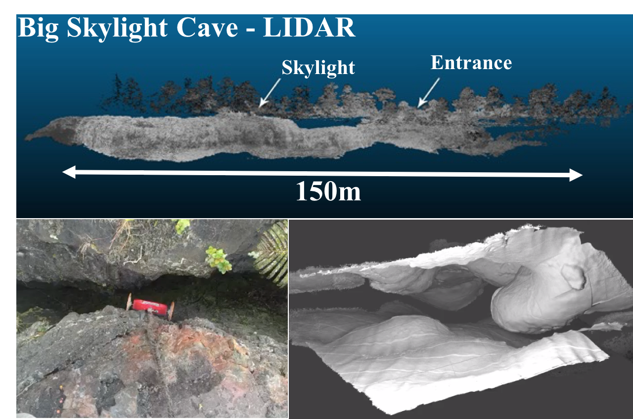
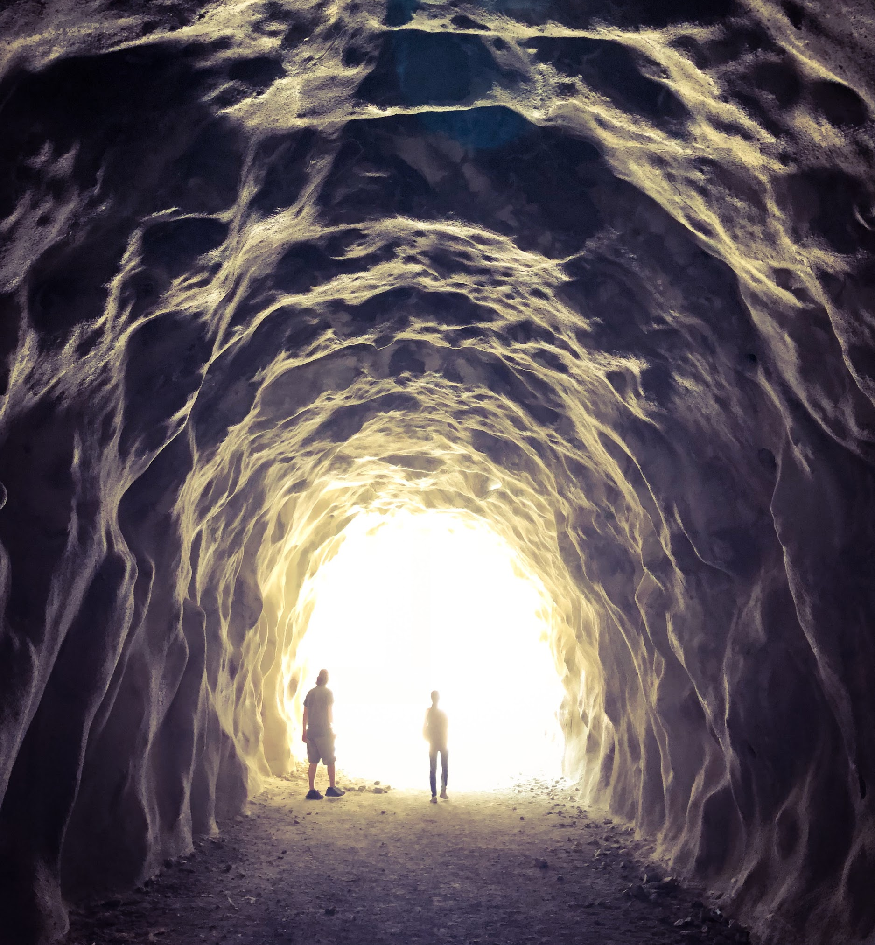
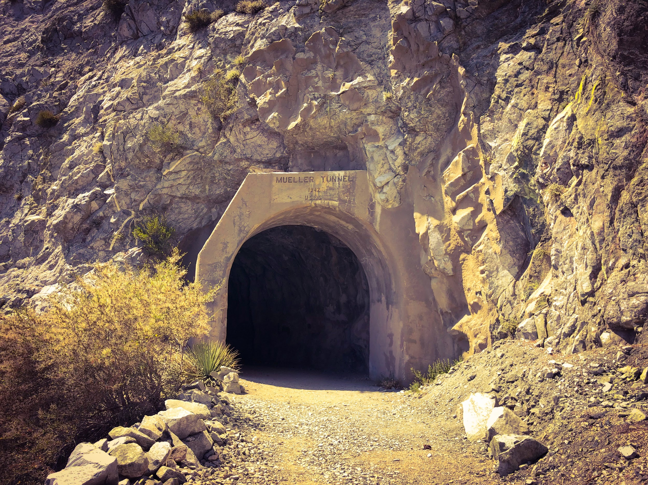
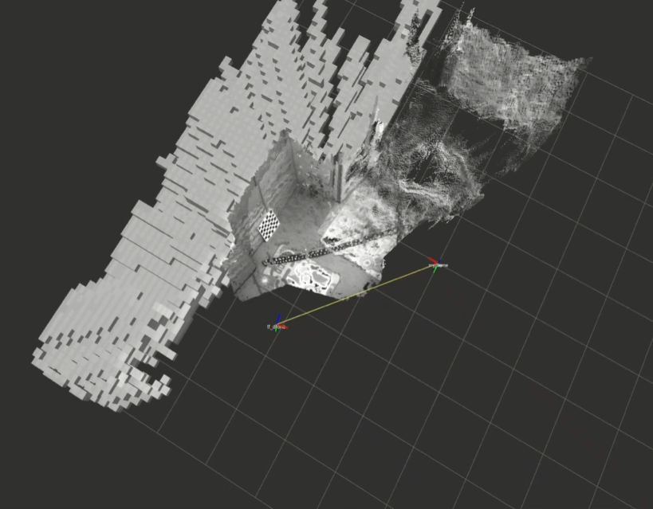
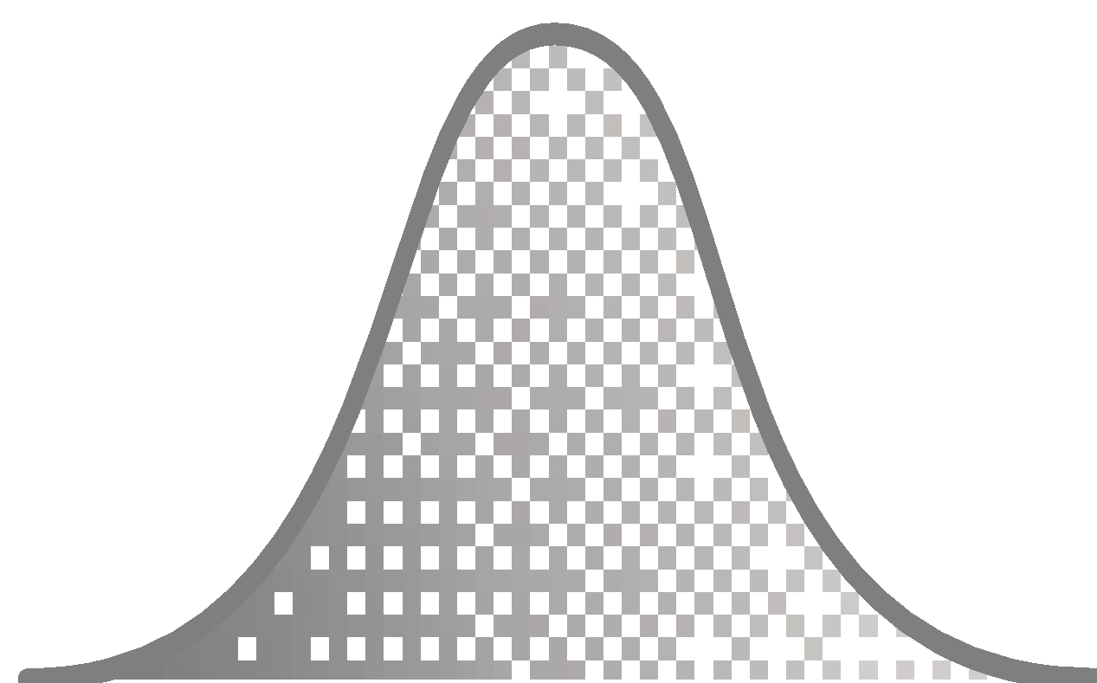
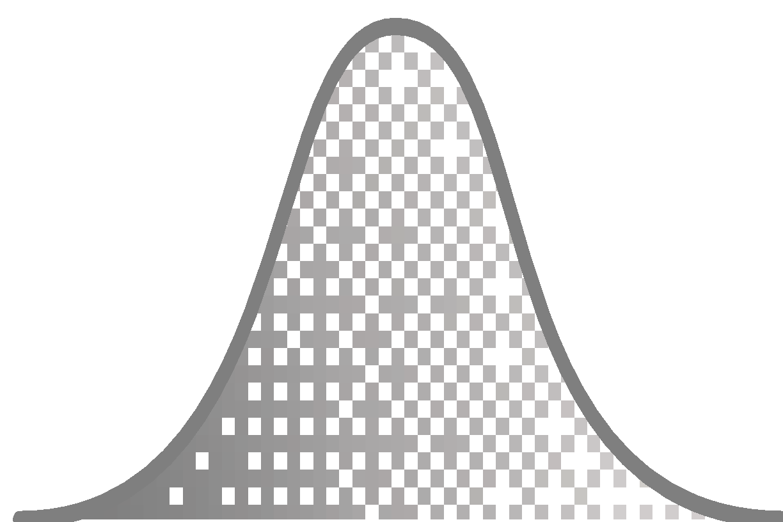
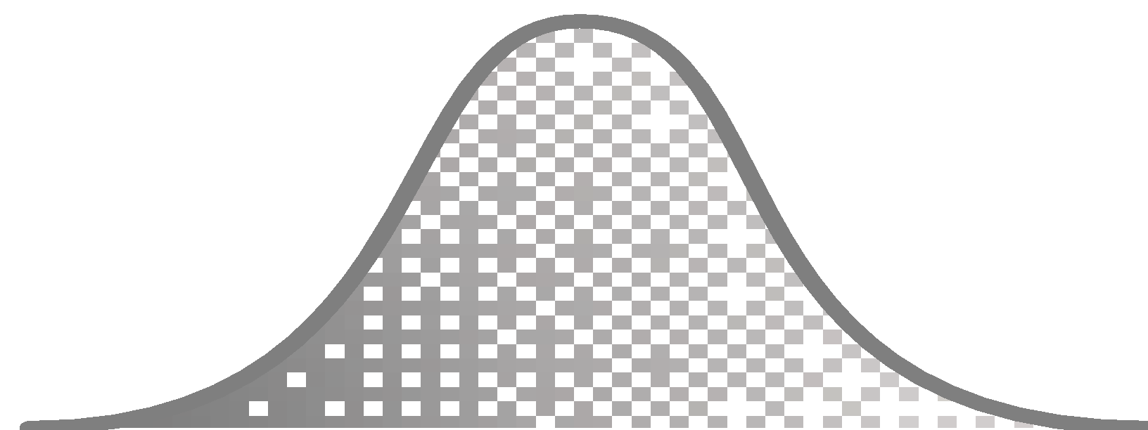
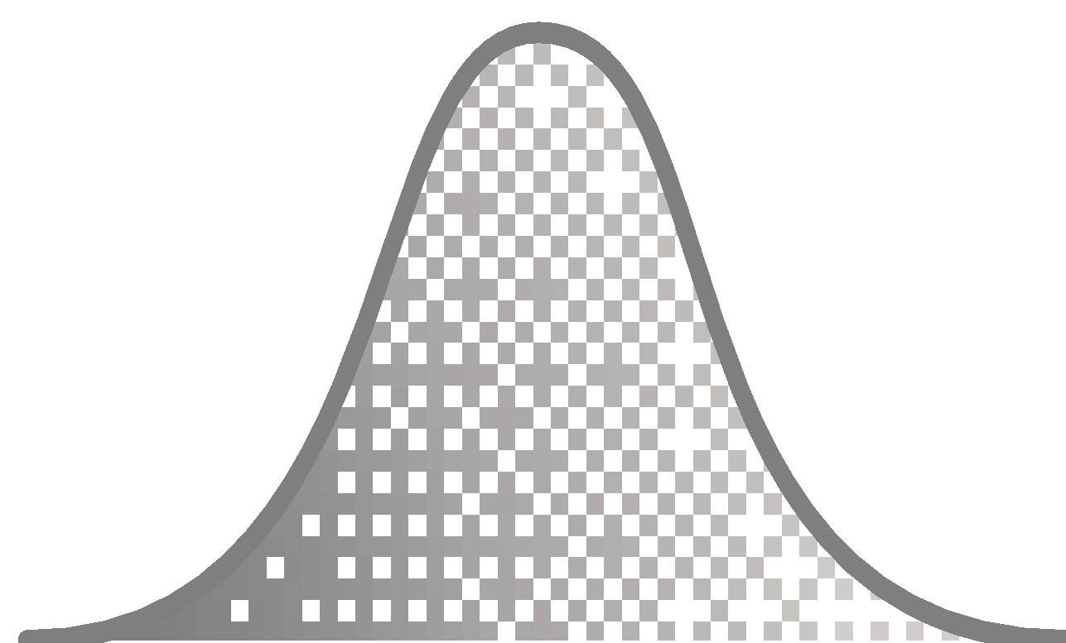
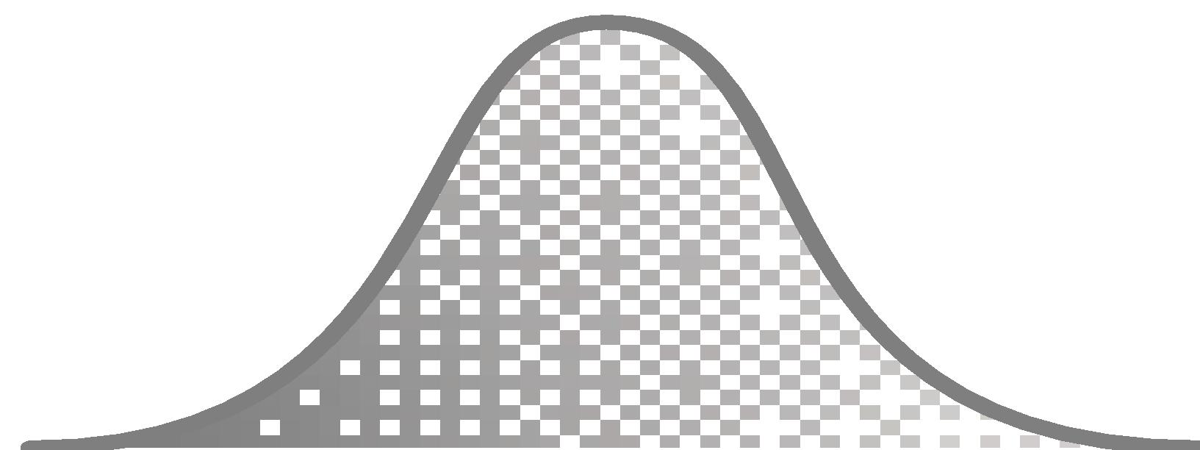
CoSTAR-bots
Collaborative SubTerranean
Autonomous
Resilient robots
Mobility
Long-endurance all-terrain mobility platform.
Localization
Onboard localization + Magneto-quasi-static-based resilient localization system.
Distributed Perception
Robust distributed perception under uncertainty using DGPO.
Communication
Disruption-Tolerant Networking.
Autonomy
Risk-aware belief space autonomy using feedback-based information roadmaps.
Mapping
High-resolution and consistent representation using Confidence-rich grid mapping.
Testing facility: Caltech’s center for Autonomous Systems and Technologies (CAST), JPL’s large Mars Yard, Mueller Tunnel, Bronson/Pisgah/Big-Skylight caves, Galvez tunnel, and potentially abandoned LA railway tunnels.

Slide 7
Timeline
May 23(?), 2018
Qualifier
August, 2018

Slide 8
High-level Schedule
Q1: Rollocopter Mobility and Autonomy
Q2: Rollocopter/rover coordination
Q3: Multi-agent Autonomy and communication
Q4: Testing and robustness
Endurance Weight Size Actuators
Main focus of Q1
Test in relevant environments
Mobility and control
Perception and autonomy
Sensor configuration

Slide 9
High-level Schedule
Qualifier
Q1: Rollocopter Mobility and Autonomy
Q2: Rollocopter/rover coordination
Q3: Multi-agent Autonomy and communication
Q4: Testing and robustness
CS/EE/ME 75
SURFs?
Plan
Prototype/Test
Integrate

Slide 10
Q1 Org Chart
Team name
- Reporting person(s)
- Deputy
Supporting/advising members
Future members
WBS | Team Responsibility
0 | Management
1 | Demo (sim and HW)
2 | Rollocopter system
3 | Rollocopter G&C
4 | Rollocopter perception
5 | Ground robot (system/autonomy/MQS)
6 | Multi-agent
7 | Communications
some text is intentionally hard to see as the people are nonexistent yet
Management
Ali Agha (PI/Task Manager)
Michael Wolf (Deputy Task Manager)
Joel Burdick (Caltech PI)
Luca Carlone (MIT PI)
Advisors
Brett Kennedy
Issa Nesnas
Larry Matthies
Aaron Ames
Darmin Arumugam
SW Arch/Policy
JP de la Croix
Kyon Otsu
Future members:
Tiago
Sunggoo
Hansoeb
Tomoki
Nobuhiro
David Shim
Thomas Lew
Leonardo Forero
--------------------------
Saptarshi
Stephanie
Gene
Cristina
Jeff Delaune
Simulation and HW demo: Kyon, DanP, Andrea, Sammi, Eric, David Chan, Jeff Edlund, Tristan
System Testing: Sammi, Navid, Micah
Rollo Perception
Ben Morrell
Sandro
Giulio
MIT student
Amanda
--------------------------
Eric
Timo
Andrea Tagliabue
Rollo HW
Arash Kalantari
Scott Harper
Kevin
Fernando
Kyle
Jairo
Gita
Meriem
--------------------------
Matt
Jong
Thomas Touma
Rollo G&C
Rohan Thakker
David Fan
Tara
Andrew
--------------------------
Jacopo
Brett
Sahand
Matt
Nikhilesh
Multi-agent
Mike Wolf
Scott Tepsuporn
--------------------------
Petter Nilsson
Communications
William Walsh
Gregory
--------------------------
Philip
Leigh Torgerson
Grobot Robot
Shreyansh
Jack Bush (MQS)
Anushri
Kamak
Caltech Class
Caltech robotic club
--------------------------
Giulio

Slide 11
Teams
Team ID | Team name | Reporting person during Q1 | Participating institutions
1 | Management | Ali | JPL
2 | Rollocopter system | Arash | JPL
3 | Rollocopter GNC | Rohan | JPL/Caltech
4 | Rollocopter perception | Ben | MIT/JPL
5 | Ground robot (system/autonomy/MQS) | Joel | Caltech
6 | Mission planning and multi-agent autonomy | Mike | JPL/Caltech
7 | Communications | William | JPL
8 | Simulation and HW demo | Kyon | JPL/Caltech
We have eight teams in the SubT projects:
Team name/ WBS | Meeting Time | Person in charge of the Agenda
Rollocopter system | Mondays 2pm-3pm | Arash/ScottH
Rollocopter GNC | Wednesdays 10am-11am | Rohan
Rollocopter perception | Tuesdays 11-12 | Ali
Ground robot (system/autonomy/MQS) | TBD | Shreyansh/Amanda
Mission planning and multi-agent autonomy | Wednesdays 4-5pm | Mike/William
Communications
Simulation and HW demo | Tuesdays 10-11 | Kyon
Management (paperwork) | Mondays 10-11 | Ali
Management (strategic) / leads meeting | Tuesdays 2-3 | Ali
All-hands meeting | Tuesdays 1-2 | Ali
All-hands backup meeting | Thursdays 11-12 | Ali
Person in charge will set up/cancel/ and invite people to meetings.

Slide 12
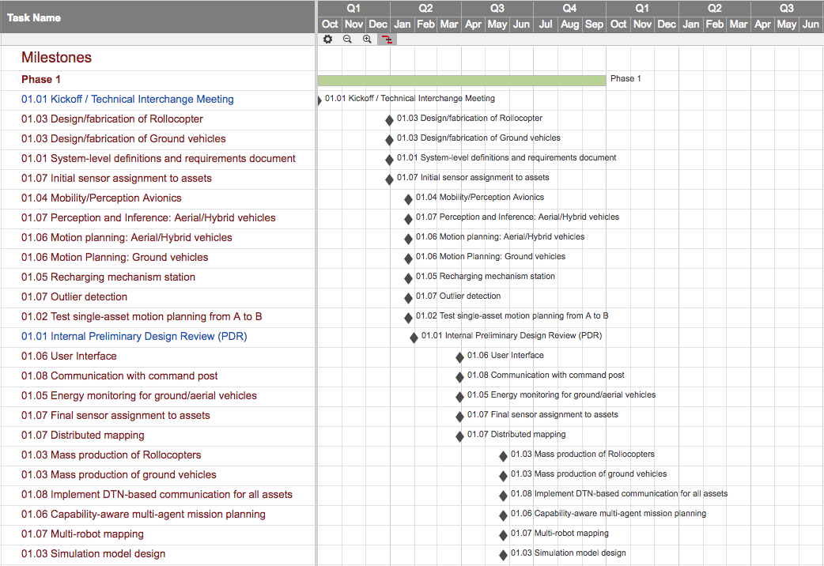
Detailed Schedule

Slide 13
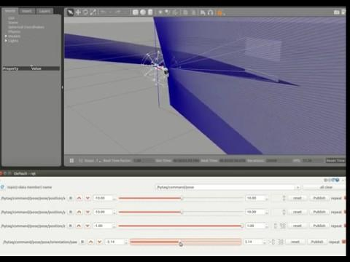
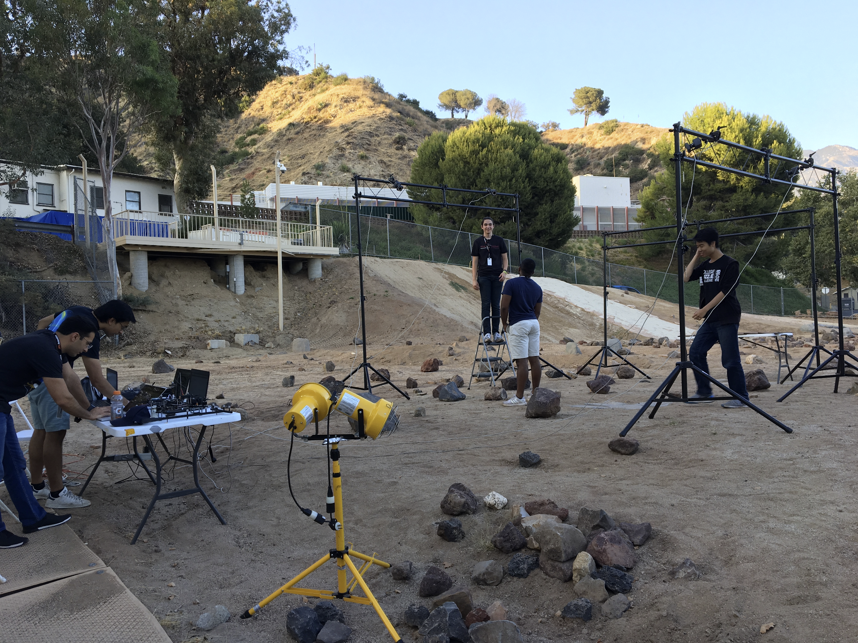
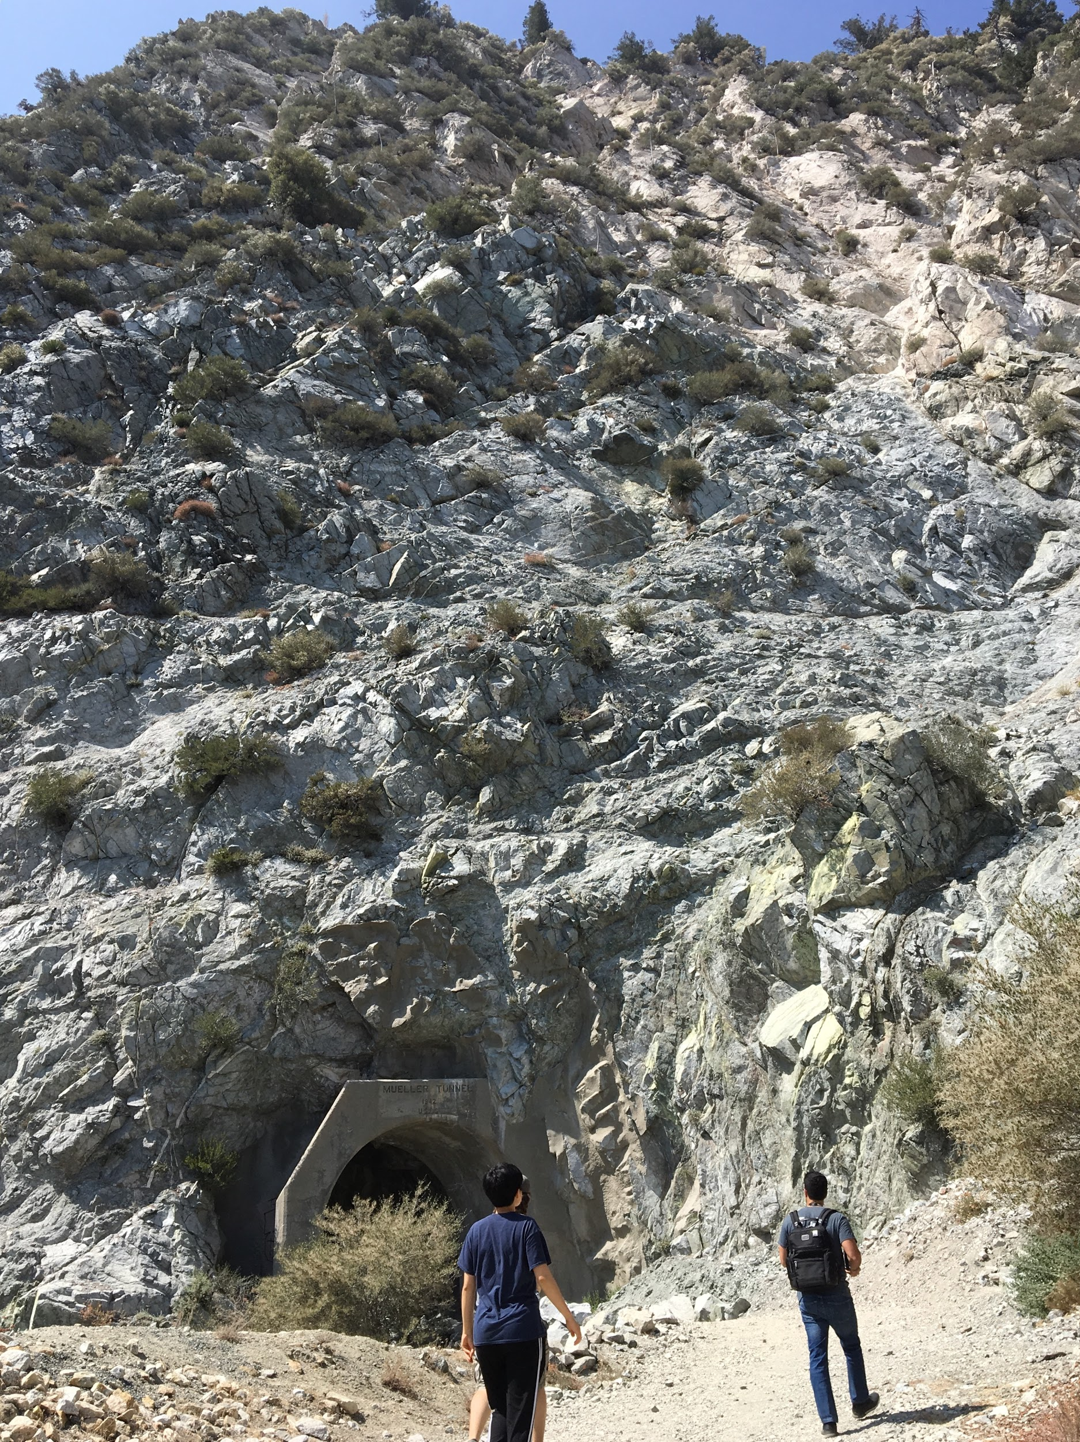
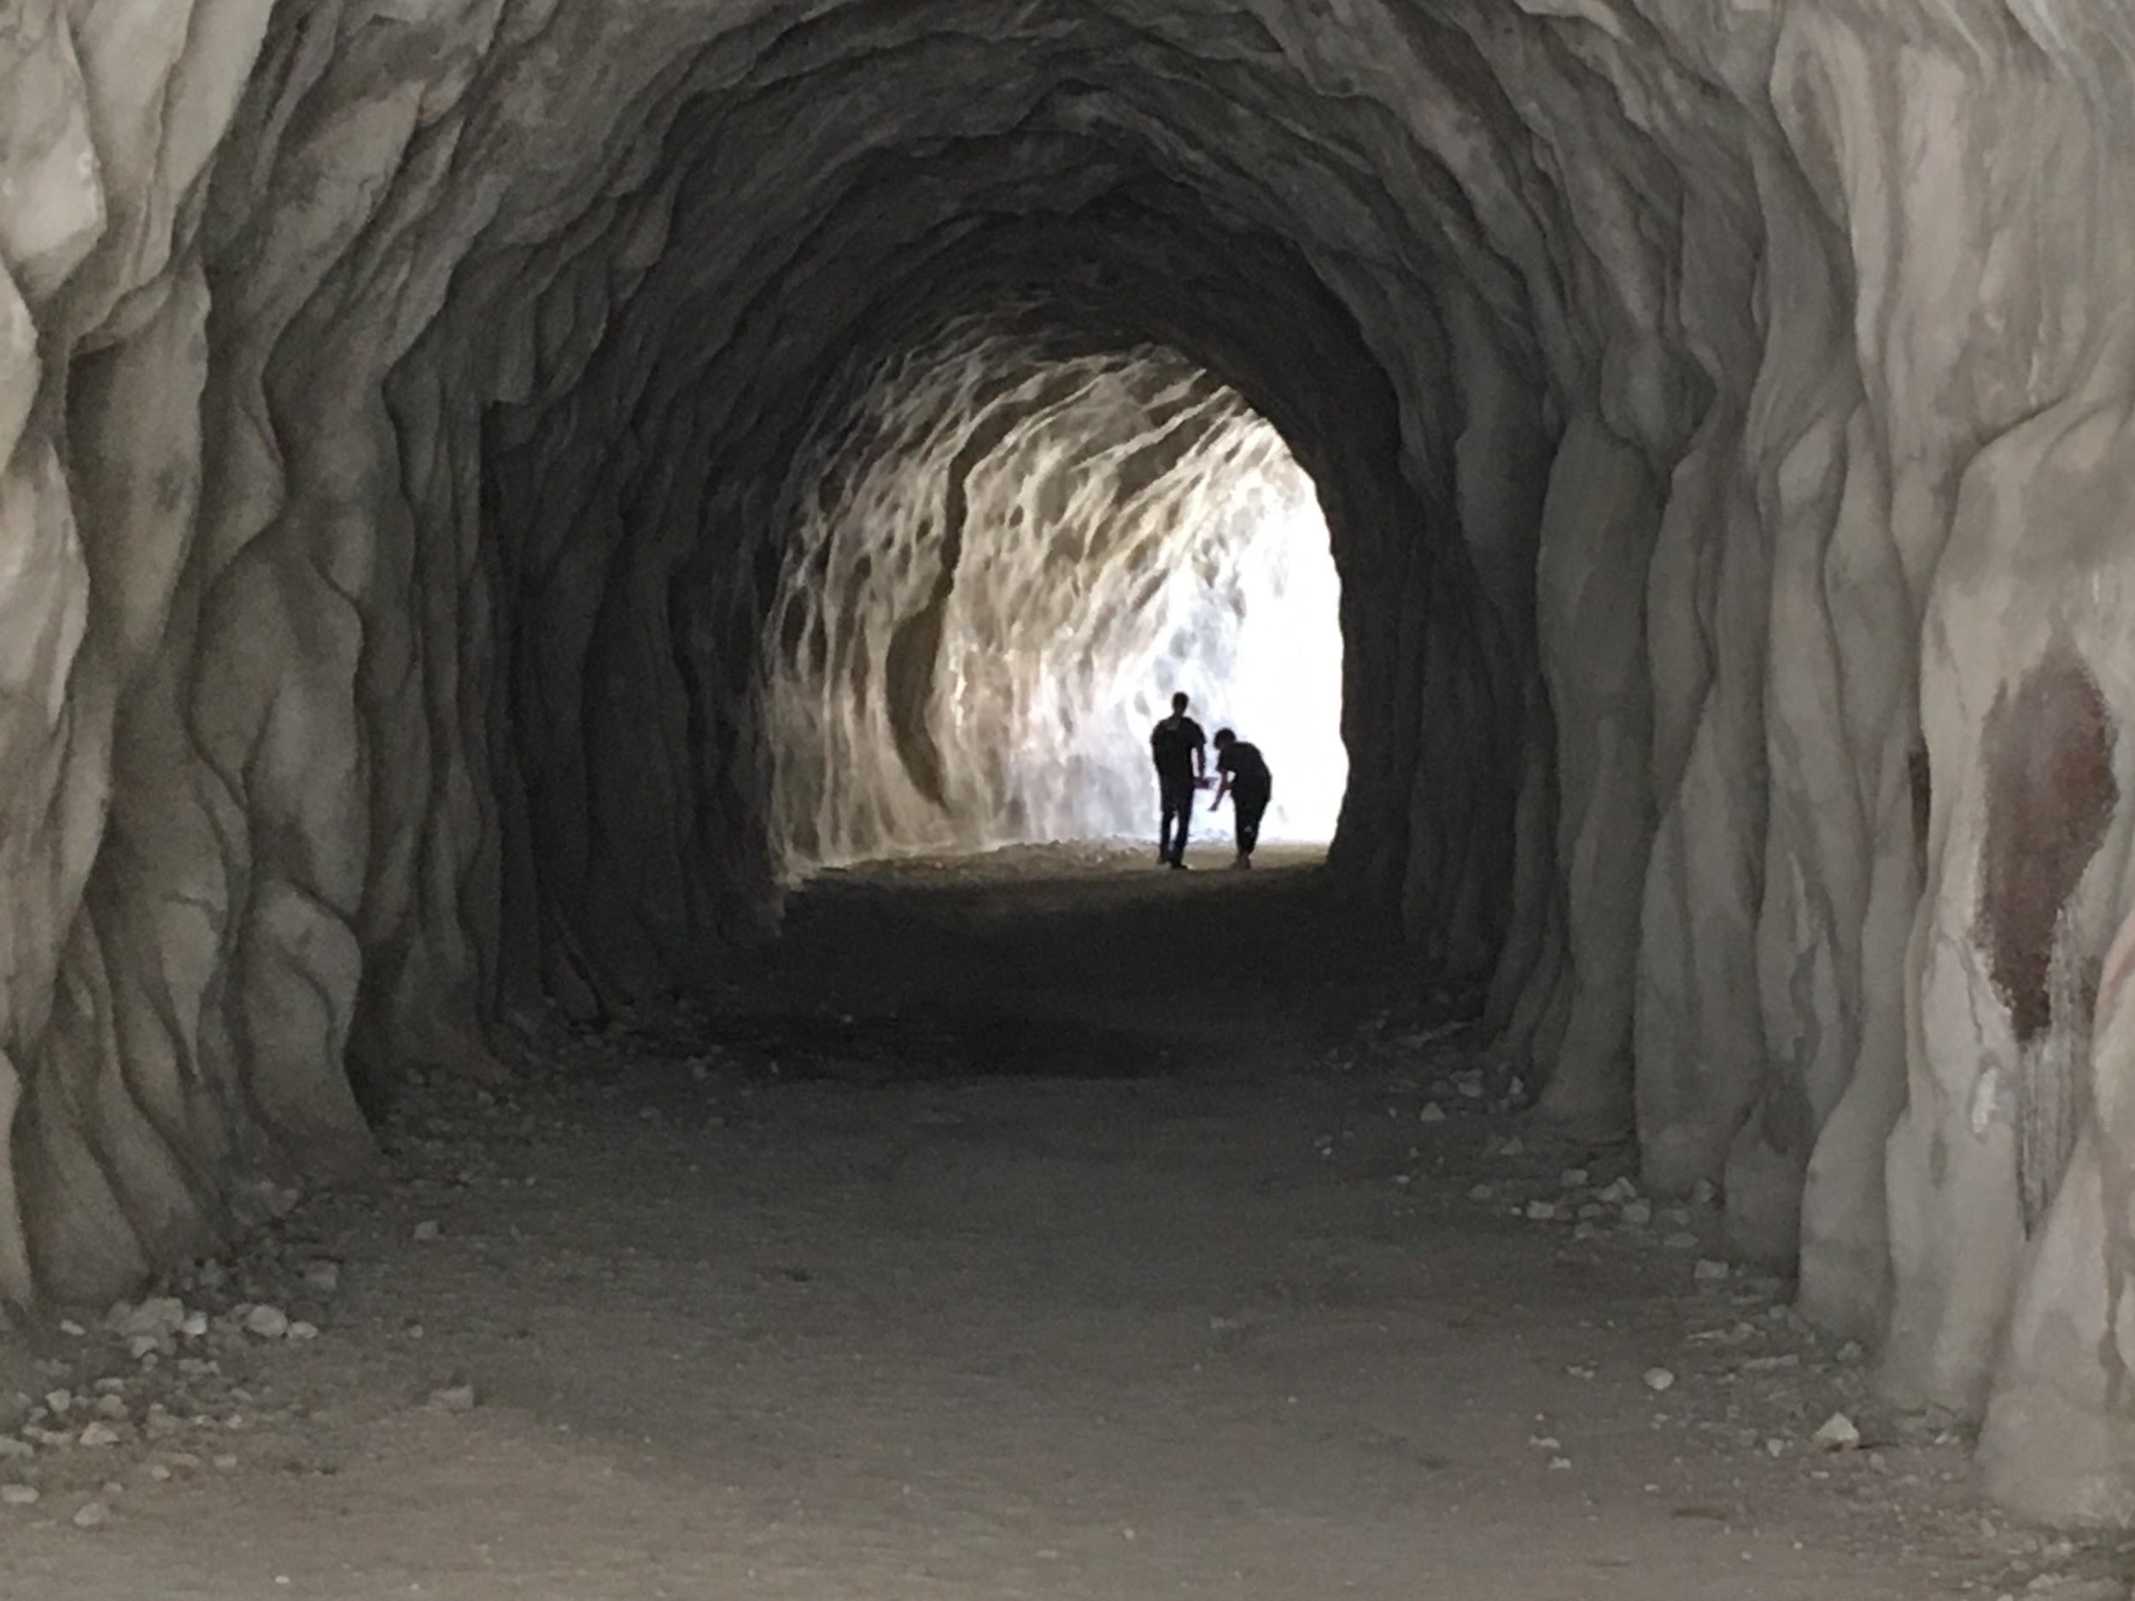
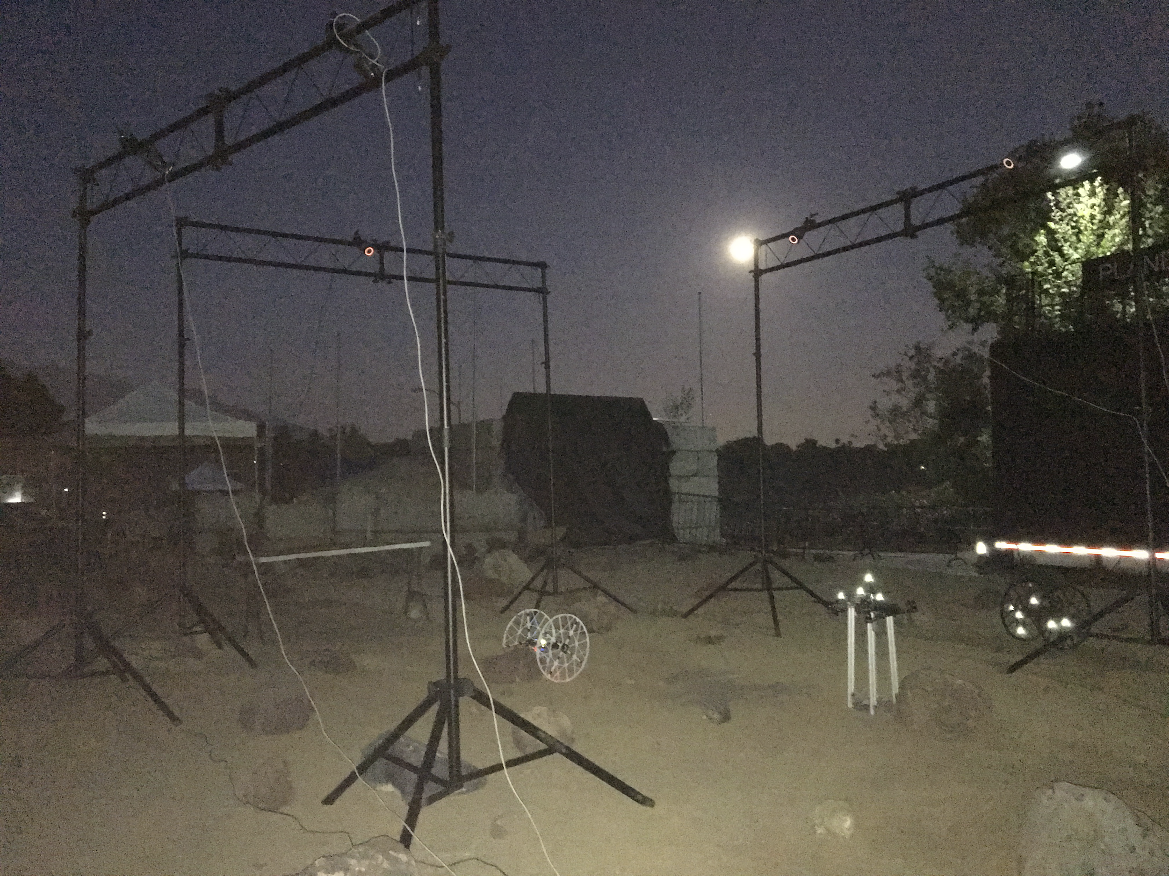
Simulation and HW Test
Preliminary setup
Mueller Tunnel
Vicon in Mars Yard

Slide 14
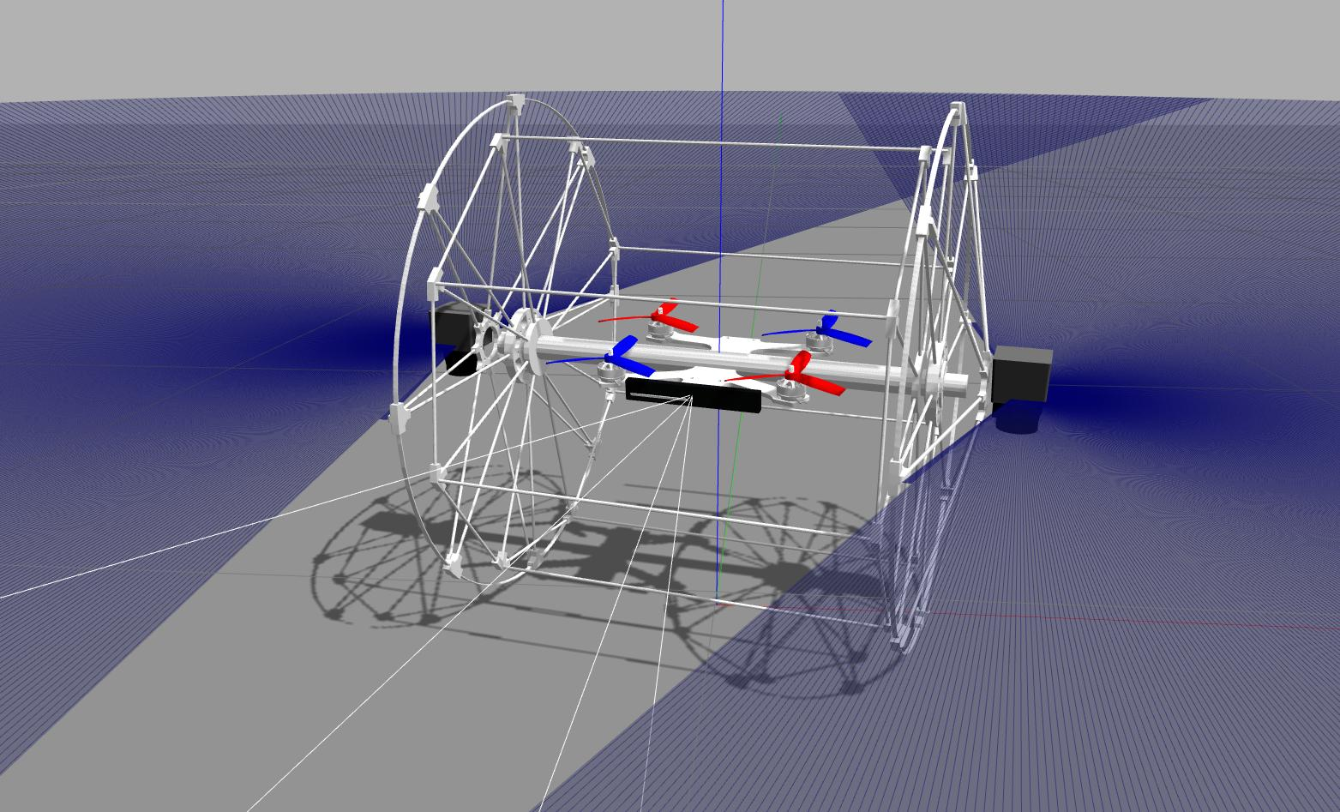
Results (Sim/HW demos)
Rollocopter-1 Gazebo model 3.0 - Dynamics and CRM mapping
Simulated motor dynamics
Sensors: IMU, realsense R200, hokuyo
Rolling and flying demo
3d model and predefined trajectory created in Blender, imaginary “cheese” robot (2 lidars) flies through indoor-like environment (rotates in all directions to increase coverage). Rviz gets overwhelmed by the large amount of voxels (8m in total (but not all visible)).

Slide 15
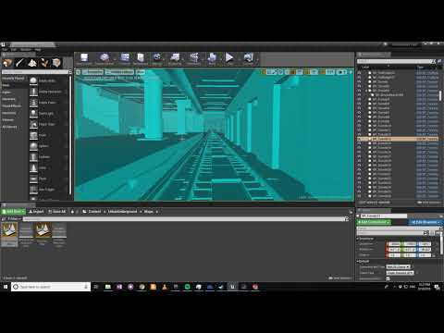
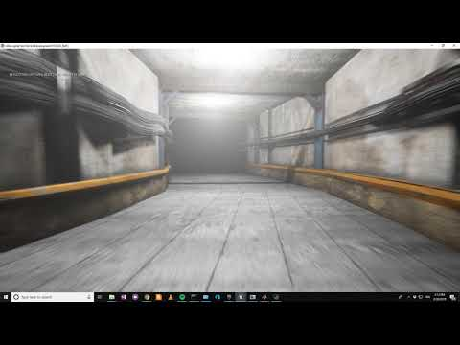
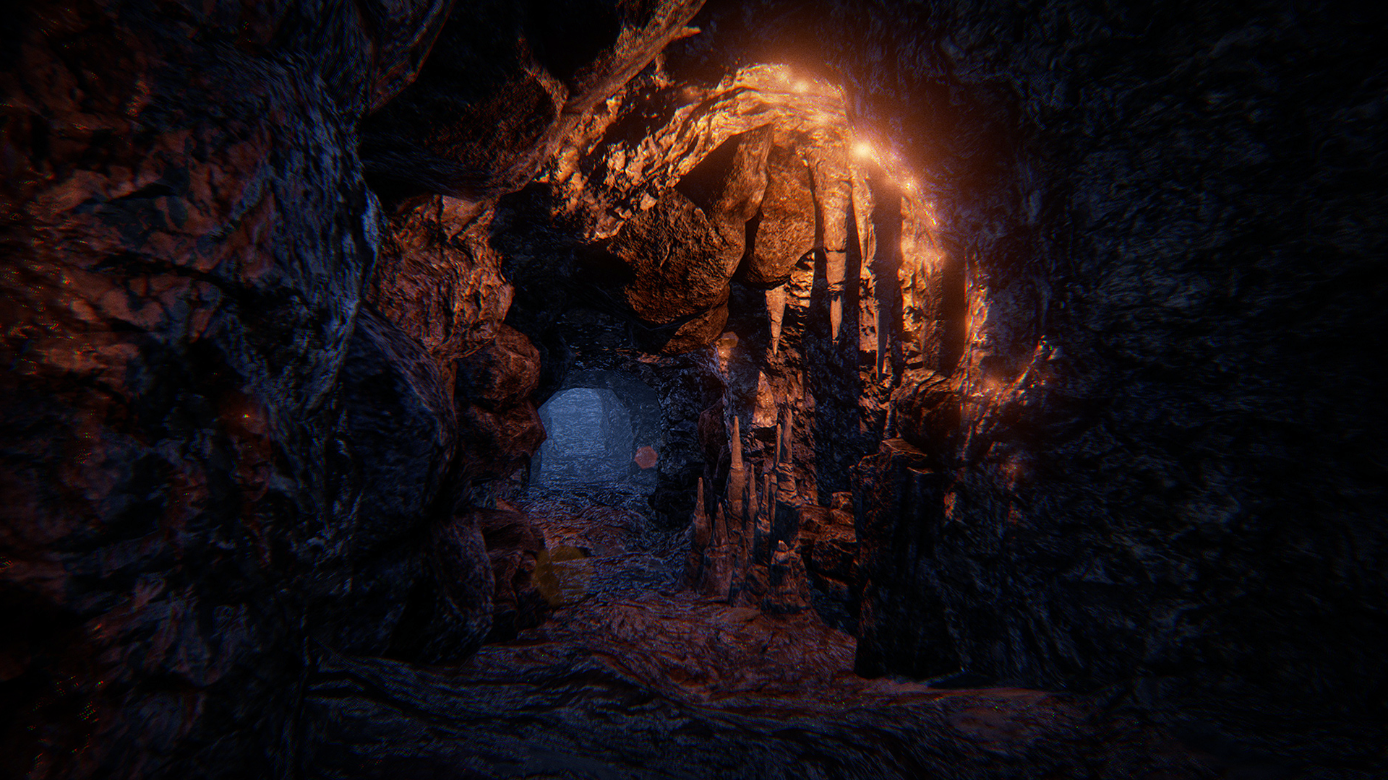
Results (Sim/HW demos): 3D Models (at Simulation/simulation_base/simulation_gazebo_worlds/models)
Purchased from Unreal Store
- High quality textures for photorealistic PR and localization testing
- 3d models, e.g. corridors, stairs, rocks, ..for level design
Cave
Metro Station
Tunnel
Created on Blender
-Simpler maps for control and mapping testing
Cave+Tunnel+Station

Slide 16
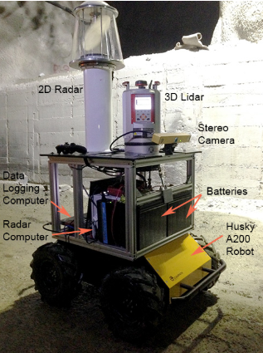
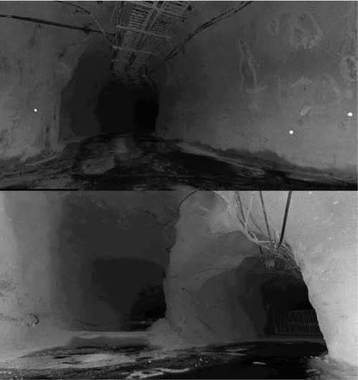
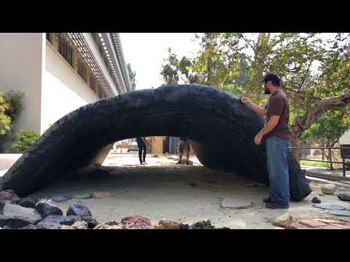
Chilean Underground Mine Dataset
http://journals.sagepub.com/doi/pdf/10.1177/0278364916679497
http://dataset.amtc.cl/
Underground cave data for pure visual odometry (no inertial data)
Results (Sim/HW demos): HW/Testing/logging
Vicon in Mars Yard
Mini Yard inflatable Tunnel
Mueller Tunnel

Slide 17
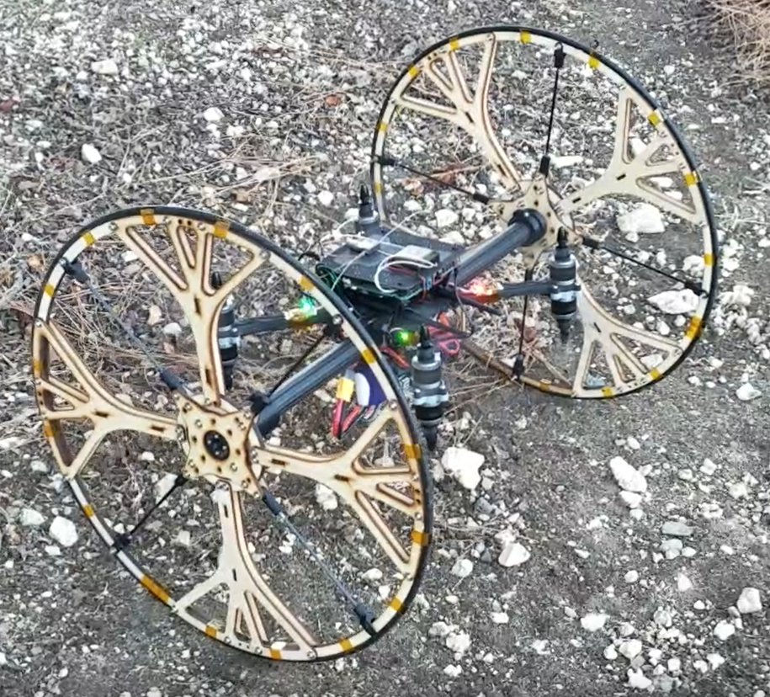
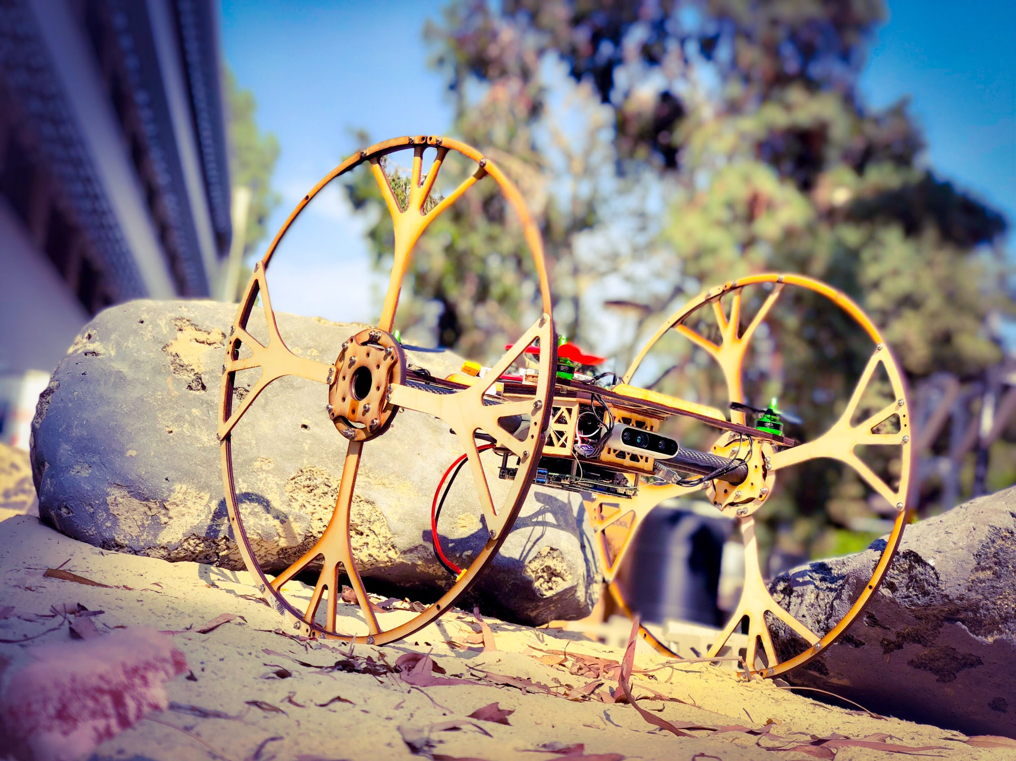
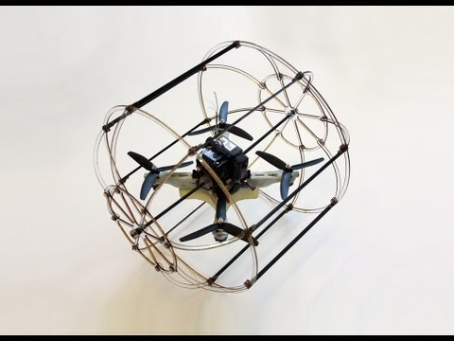
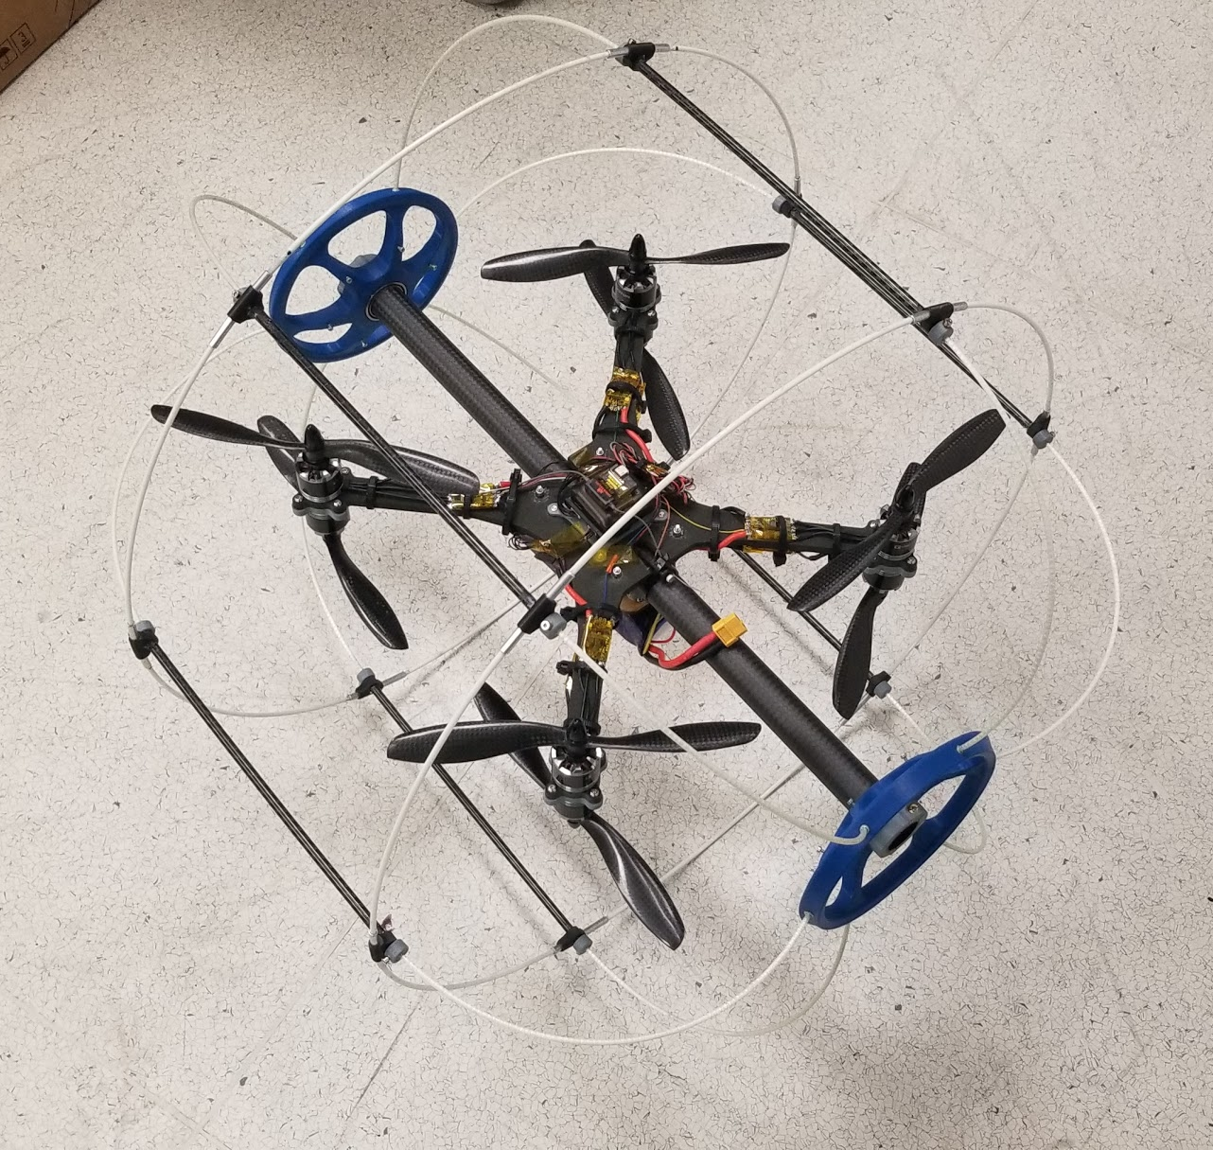
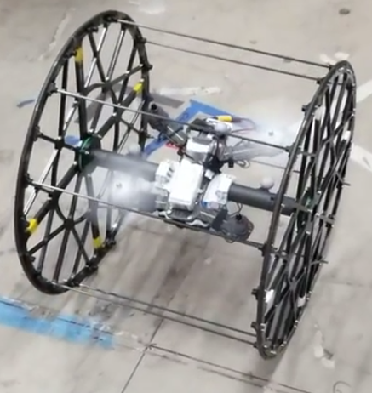
Mobility
Endurance Weight Size Actuators
Test in relevant environments
Mobility and control
Vehicle evolution
Perception and autonomy
Sensor configuration

Slide 18
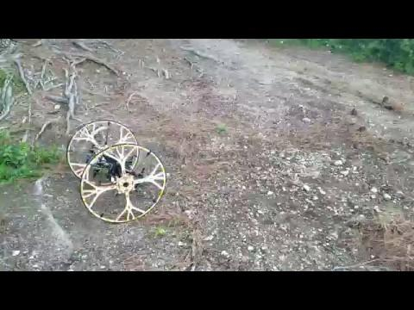
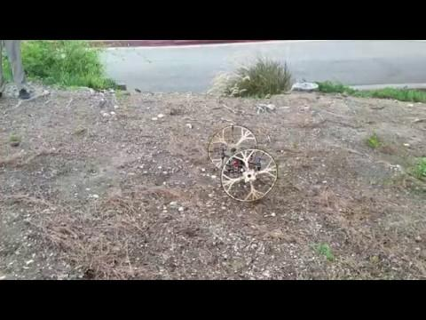
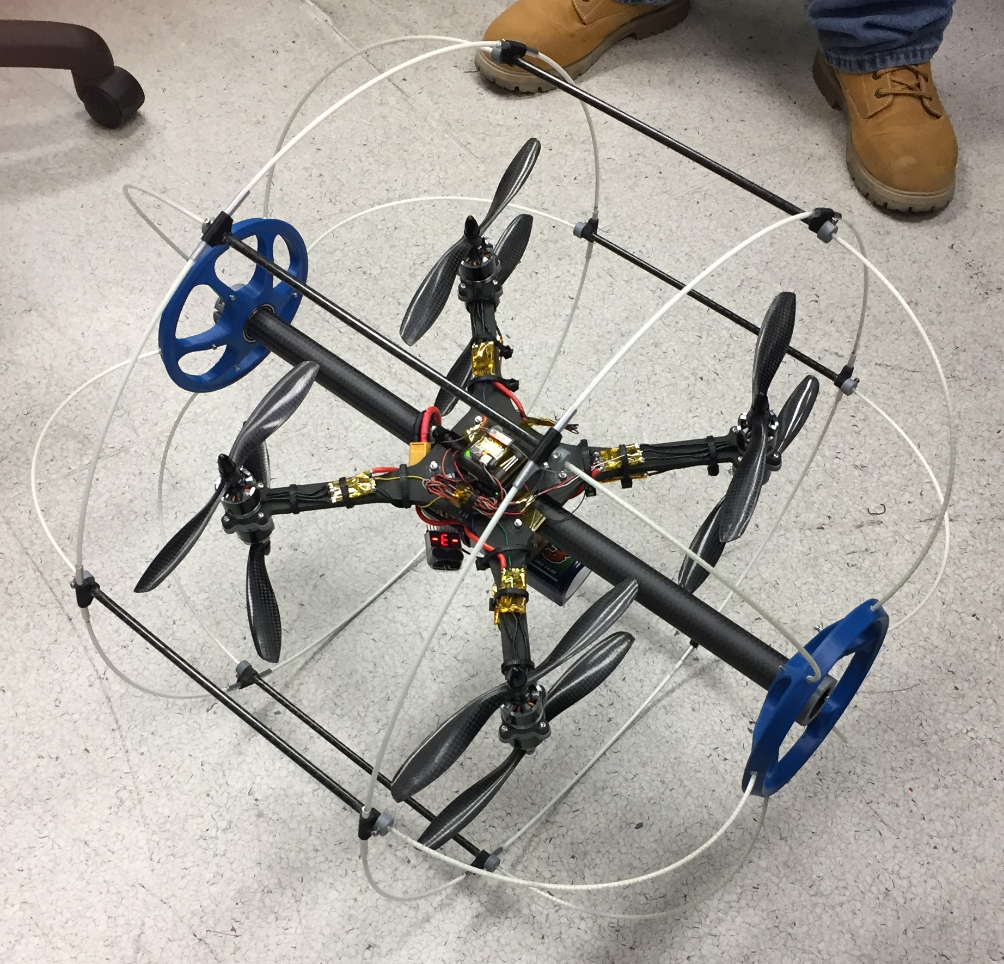
New Rollocopters

Slide 19
Rollocopters: Improvement #1: Tiltrotors
Goal: Build versions of the rollocopter with tilting rotor axes. (build a 4 rotor and 3 rotor version)
Motivation: the ability to tilt the rotors improves many capabilities:
Should be more efficient while rolling
Pushes dust behind the sensors
Better control of sensor pointing
Better maneuverability and stopping
Activity: Build a 4 rotor or 3 rotor tilting rotor rollocopter
Contacts:
Caltech: Amanda Bouman (grad student) abouman@caltech.edu
JPL: Arash Kalantari arash.kalantari@jpl.nasa.gov

Slide 20
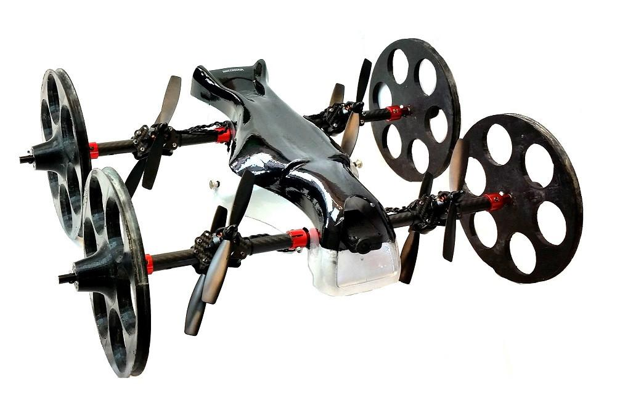
Rollocopters: Improvement #2: 2 or 4 wheels?
Goal: Determine if 2 wheels or 4 wheels provide better operation on the ground. Or, propose some other novel ground mobility idea.
Motivation: high performance ground mobility of the rollocoptor is an important performance objective.
Activity: Build a 4 wheel version of the rollocopter. Compare it to the 2-wheeled version in terms of energy usage and maneuverability
Contacts:
Caltech: Drew Singletary drewsingletary1@gmail.com

Slide 21
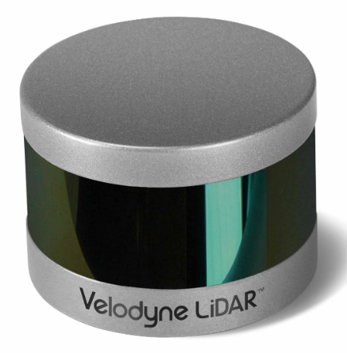
Project: ground mobility system #1
Goal: Equip a Husky robot with a sensor system.
Motivation: Ground robots will be play an important role in energy distribution and communication in the underground environment
Activity: Equip a Husky robot with (1) Velodyne ladar, (2) multiple Intel Real Sense sensors; (3) a NUC multi-core computer. After the vehicle is equipped, also develop a motion planning system.
Contacts:
Caltech: Anushri Dixit (grad student): adixit@Caltech.edu
JPL: Ali Agha (team lead): aliakbar.aghamohammadi@jpl.nasa.gov

Slide 22
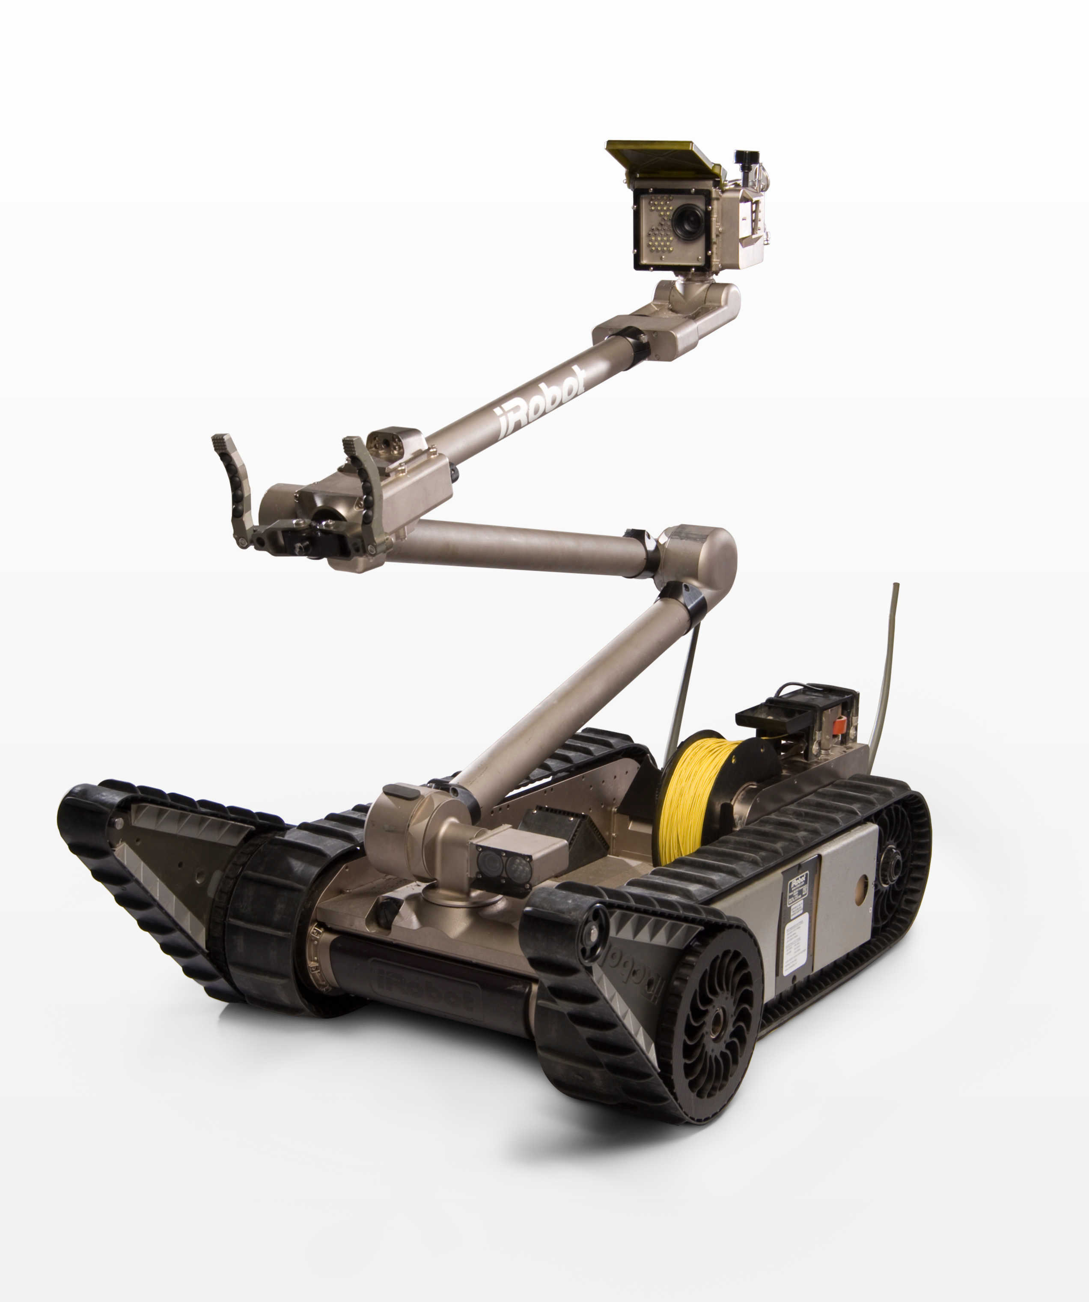
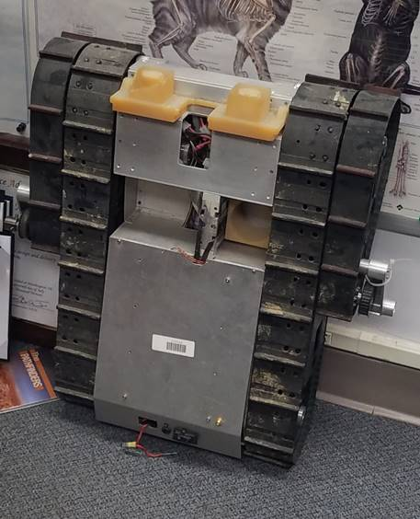
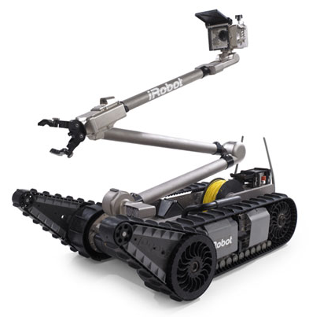
Project: ground mobility system #2
Goal: Renovate a PacBot tracked robot.
Motivation: Tracked robots have excellent mobility over rough terrain.
Activity: Interface the existing PacBot with a new on-board computing system (Intel NUC), and equip it with: (1) Velodyne ladar, (2) multiple Intel Real Sense sensors. After the vehicle is equipped, also develop a motion planning system.
Contacts:
Caltech: Joel Burdick: jwb@robotics.caltech.edu
JPL: Ali Agha (team lead): aliakbar.aghamohammadi@jpl.nasa.gov

Slide 23
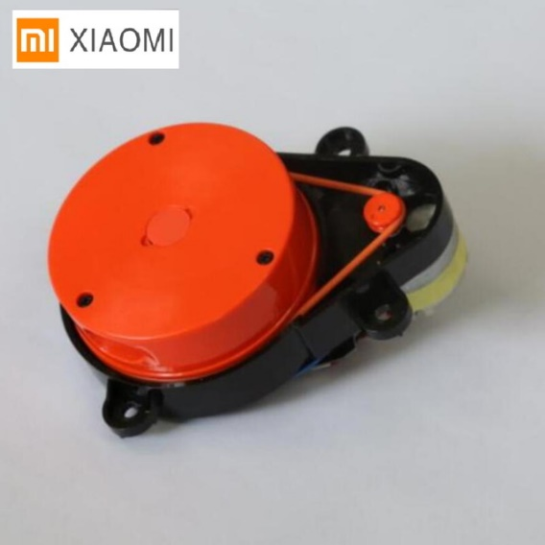
Project: Sensing #1
Goal: Build a 3D Lidar from a 2-D scanning Lidar
Motivation: 3D lidars provide essential data for navigation, but they are heavy and expensive.
Activity: Add a motorized tilting axis to a low cost, low mass, 2D scanning lidar. Develop the sensor processing algorithms to structure the Lidar data in a 3D map.
$4,000 and 560 grams
$100 and ~120 grams
Contacts:
Caltech: Anushri Dixit, Joel Burdick: adixit@caltech.edu, jwb@robotics.caltech.edu

Slide 24
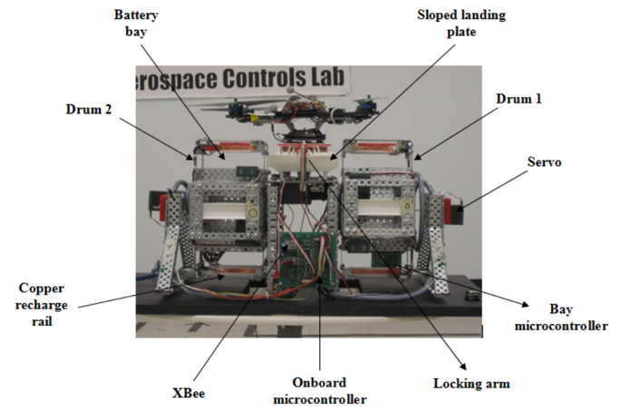
Battery swap/ recharging technology
Goal: Build a recharging station for drones
Motivation: During the competition, it is likely that the drones will run out of energy before the mapping is complete. Recharging will ensure full operational capability
Activity: Design and build a system which will allow a drone to autonomously land and recharge its batteries, or receive a fully charged battery swap.
Contacts:
Caltech: Joel Burdick: jwb@robotics.caltech.edu
JPL: Ali Agha (team lead):
aliakbar.aghamohammadi@jpl.nasa.gov

Slide 25
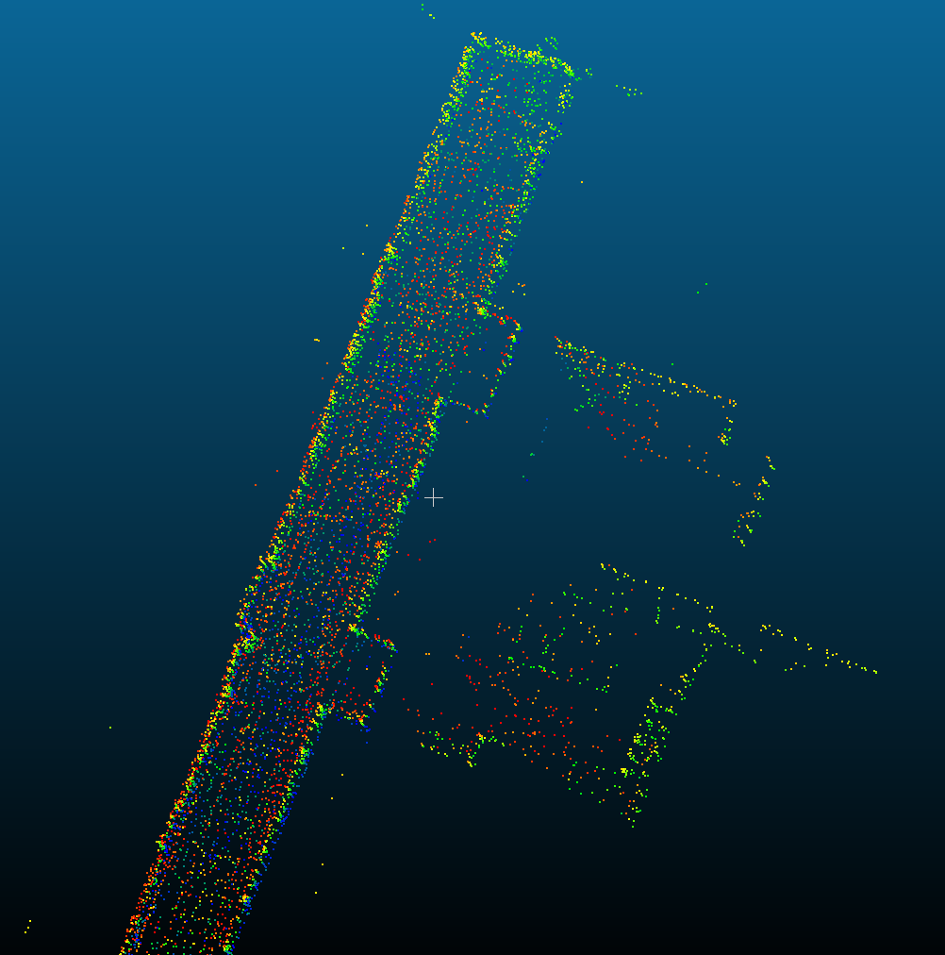
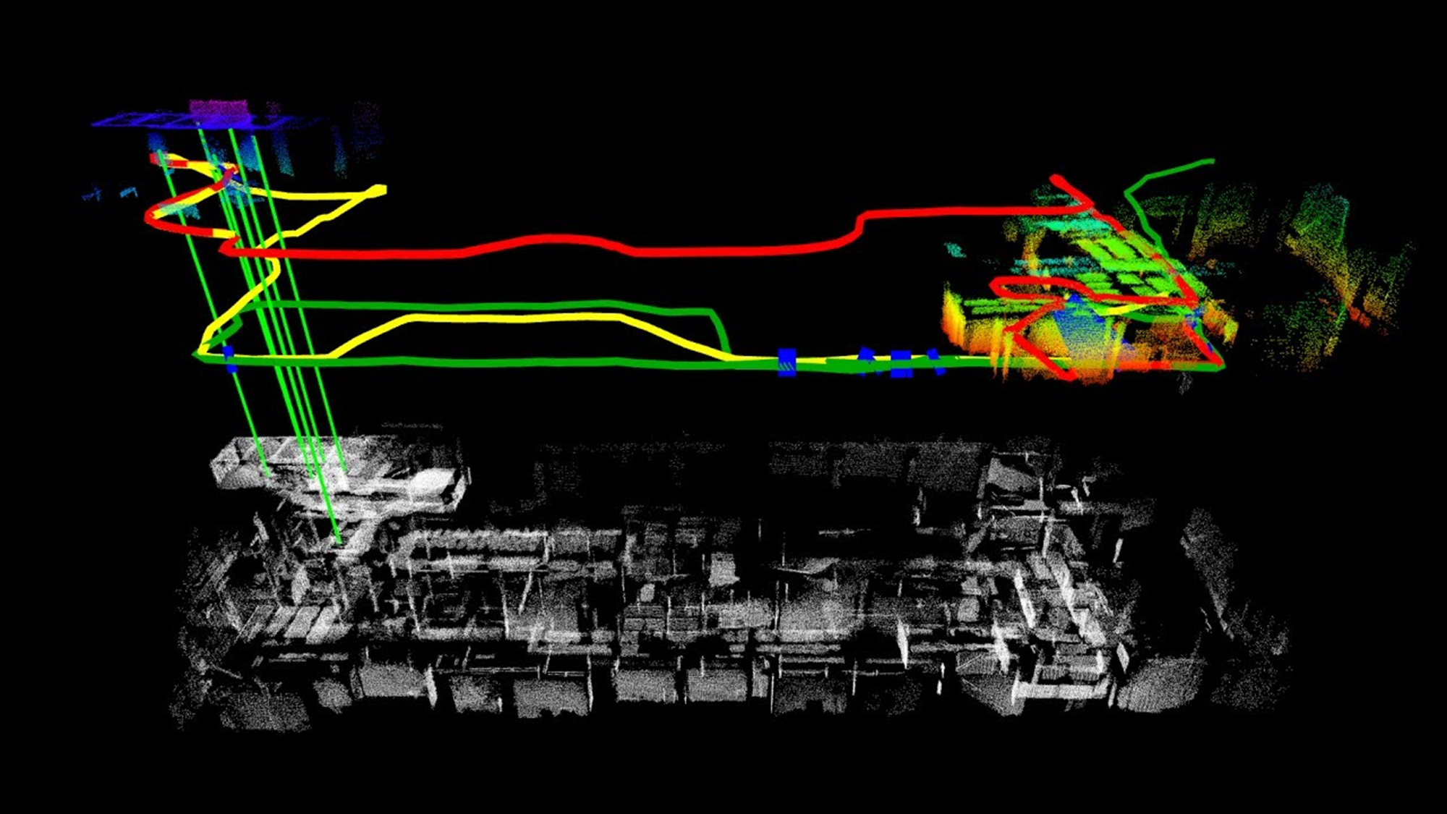
Project: Mapping #1: MultiRobot Mapping
Goal: Develop a mapping system that merges data from multiple robots and multiple sensor types
Motivation: High quality maps are essential to success in the competition.
Activity: A first effort will focus on extending an existing mapping algorithm and software package to multi-robot use. Advanced work will develop a system from scratch.
Contacts:
Caltech: Anushri Dixit, adixit@caltech.edu
JPL: Rohan Thakker: rohan.a.thakker@jpl.nasa.gov

