Slide 1
CS/EE/ME 75(a)
Oct. 29, 2018
Today:
Structured Design Artifacts
GOTChA Chart
Objective Tree
System Architectures
Teaming & Projects
Homework

Slide 2
Structured Design Method(s)
Recognition of a Need
Design is a process that has a general structure.
Problem Definition
Solution Generation
Analysis & Optimization
Prototyping

Slide 3
Structured Design Method(s)
The System Engineering Process should have structure
Structured flow of the problem solving process
Structured components of each step
Structured design methods for each step
Structured Artifacts to capture, archive, and disseminate the steps of the design process

Slide 4
Structured Design Method(s)
Recognition of a Need
Clarification of Objectives
Establish Function
Set Requirements
Problem Definition
Generate Alternatives
Evaluate Alternatives
Create Details
Solution Generation
Analysis & Optimization
Prototyping

Slide 5
Structured Design Method(s)
Recognition of a Need
Clarification of Objectives
Objective Tree
GOTChA chart
Establish Function
Function Diagrams
System Architecture
Set Requirements
Specifications
Problem Definition
Solution Generation
Analysis & Optimization
Prototyping

Slide 6
(Structured) Design Artifacts
Main Idea:
Capture key steps of the design process
Communicate intent.
Provide directions to designers, developers, testers
Different artifacts needed for different users and process stages
Users
Stakeholders: the people affected by the system design & deployment
Management
Design, Development, and Test Teams

Slide 7
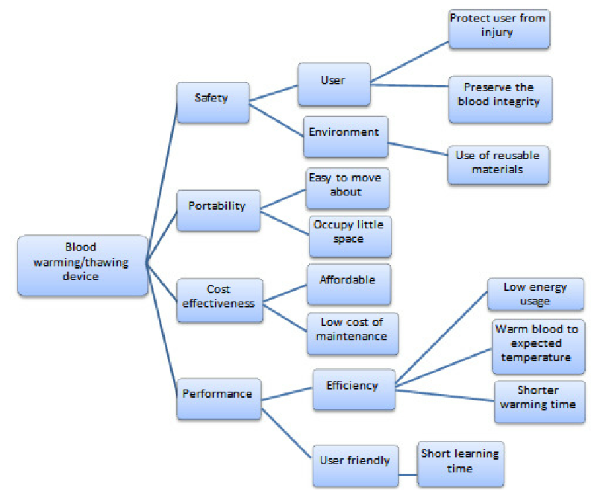
Objective Tree
Why
How

Slide 8
GOTChA Charts
(for developers and managers)
GOTChA :
Goals
Objectives
Technical Challenges
Approach
Use a Quad Chart structure
Goals: high level description of main goal(s) and desired results of the project/effort
Technical Challenges: list expected difficulties
Challenge 1
Challenge 2
Challenge 3
Objectives: list of objectives required to meet goal
Obj. 1: <obj > < date >
Obj. 2: <obj> < date >
Approach: list of proposed methods to realize goals/objectives
Act. 1: < build a model >
Act. 2: < simulate the model >
Act. 3: < design experiment

Slide 9
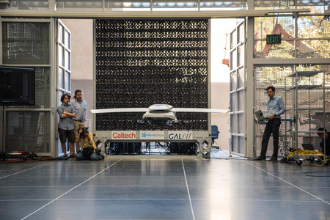
Learning to Fly Anima Anandkumar (animakumar@gmail.com), Joel Burdick (jburdick@caltech.edu, 626-395-4139), Soon-Jo Chung (sjchung@caltech.edu), Yisong Yue (yyue@caltech.edu),
Need/Justification:
Vehicle performance can be strongly affected by nonstationary and variable effects in its surrounding fluid flow
Current practice relies upon exhaustive and expensive wind-tunnel testing to refine control system design and performance.
Rigorous nonlinear, optimal, stochastic control techniques that incorporate learning could improve performance, and lower wind-tunnel and flight testing costs.
Objectives: Based on theoretical, simulation, and experimental investigations, this effort will demonstrate in the CAST center at Caltech the ability for autonomous fixed wing aircraft and rotorcraft to safely and stably incorporate real-time learning of changes in environmental and system dynamics. We will build and demonstrate this capability through 5 demonstrations, and quantify the efficiency, robustness, and effectiveness of the techniques.
Approach: The proposed program will incorporate the following activities.
1. Theory & Algorithms: We will explore and compare multiple approaches to dynamic model learning based on Gaussian Processes, Koopman Spectral Techniques, and Reinforcement learning. For safety and stability we will investigate and compare new techniques in Control Barrier Functions, safe optimization, and nonlinear stochastic optimal control and stabilization. New techniques that blend the novel learning and nonlinear control methods will be developed and compared.
2. Simulations: We will develop strip-based aerodynamic models of the CAST flying ambulance to vehicle to serve as a starting model for the learning processes.
3. Experiments: We will instrument and gather data from a fixed wing and multi-rotor craft operating in unsteady flow conditions in the CAST center at Caltech.
4. Demonstrations: Demonstrations are planned every 6 months as an integrating focus and as a procedure to evaluate progress, and evaluation methodology.
5. Knowledge transfer: technical papers, copies of the prototype code and algorithms used in CAST demonstrations, data resulting from simulations and tests, seminars at Raytheon Missile, exchange of student interns and researchers with Raytheon Missile.
MILESTONES & SCHEDULE:
Proposed 2018/2019 Budget: $535k
TASKS/MILESTONES
2018 2019 2020
Develop/improve Test-Bed
Gather flight data
Learning Theory
4. Safety/Stability/
5. Control theory
6. Real-Time Optimization
7. Demonstration preparation
_{M1}
_{M2a}
_{M2b}
_{M3a}
_{M3b}
_{Q1}
_{Q2}
_{Q3}
_{Q4}
_{Q1}
_{Q2}
_{Q3}
_{Q4}
_{H1}
_{H2}
Research Actuals/Budget
or Budget Proposal
_{106k}
_{85k}
_{86k}
_{86k}
_{86k}
_{86k}
_{176k}
_{176k}
Notes:
2
2
2
2
2

Slide 11
Final event

Slide 12
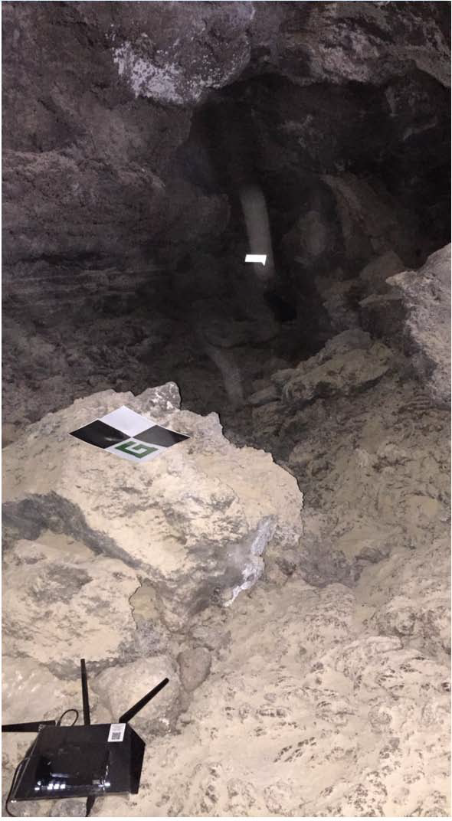
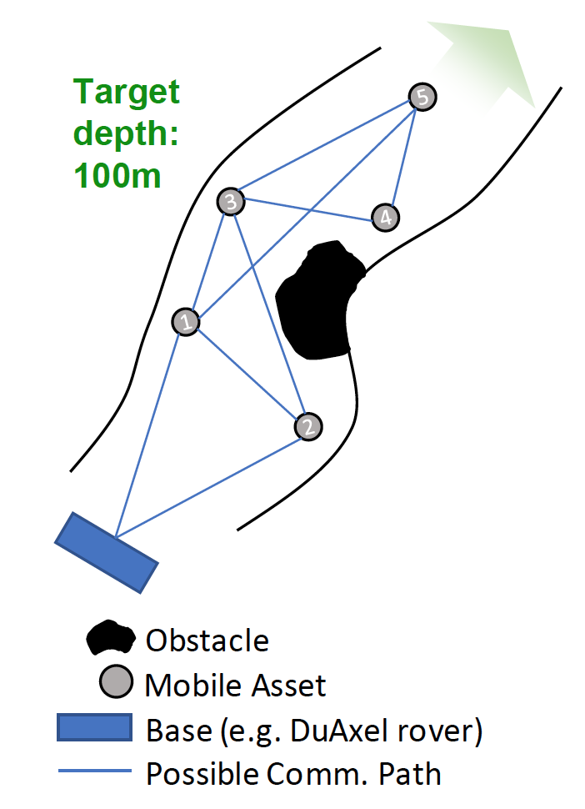
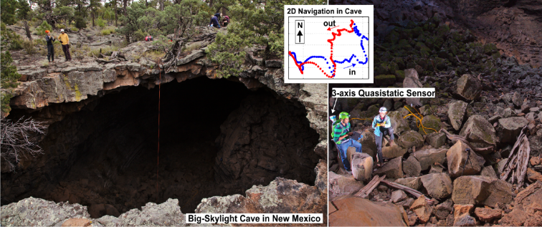
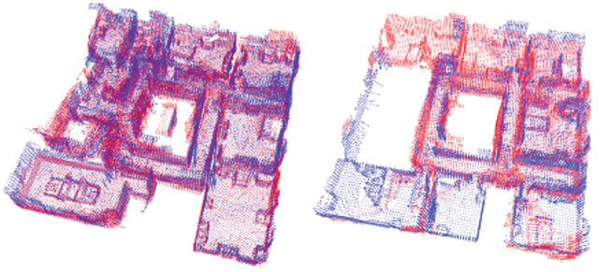
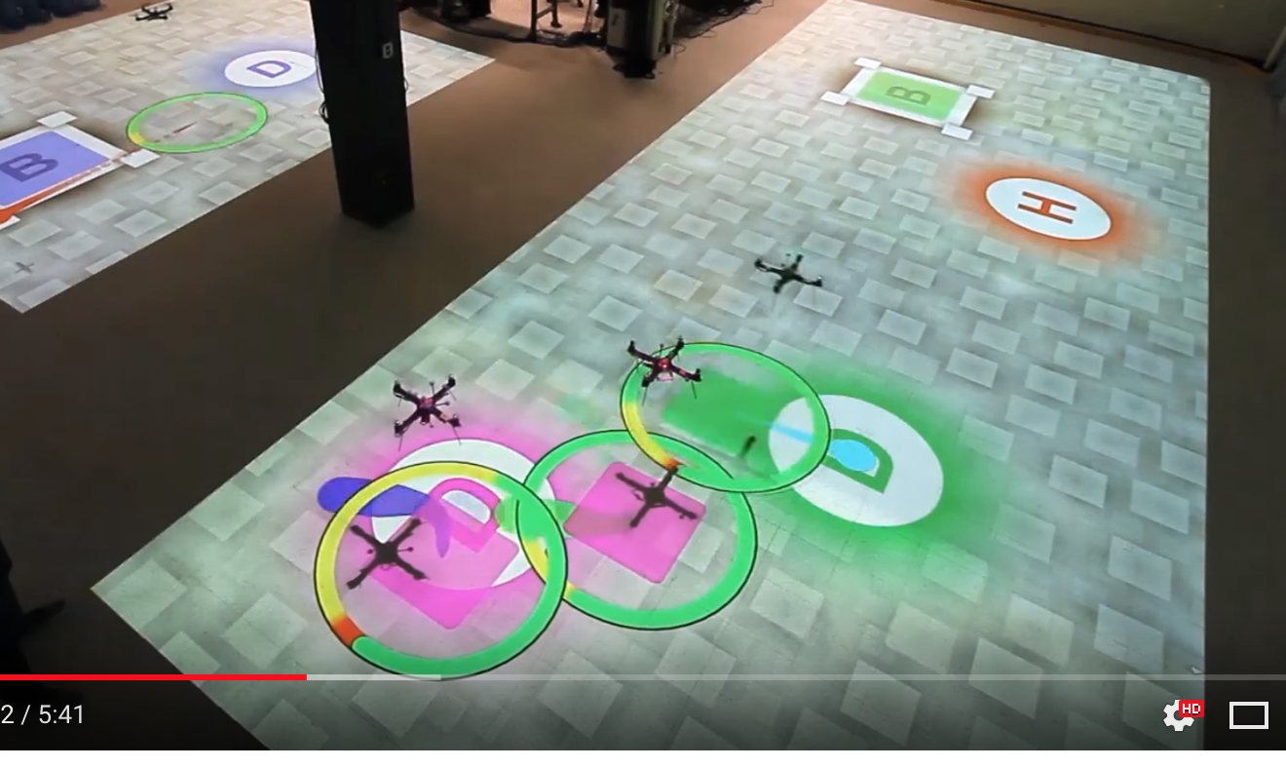
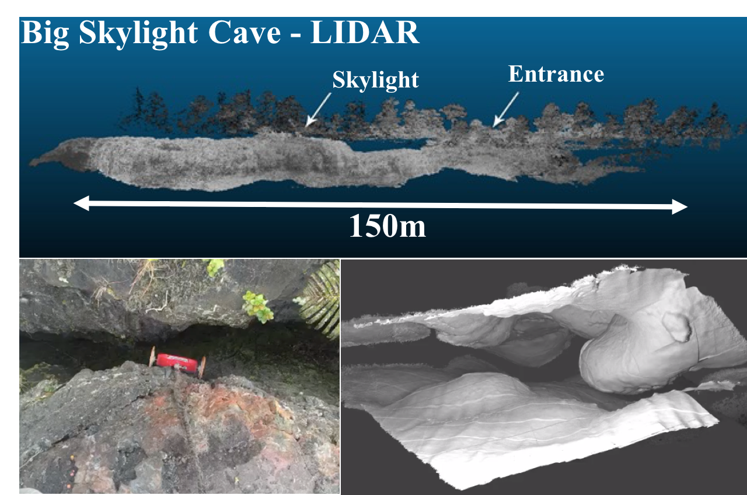
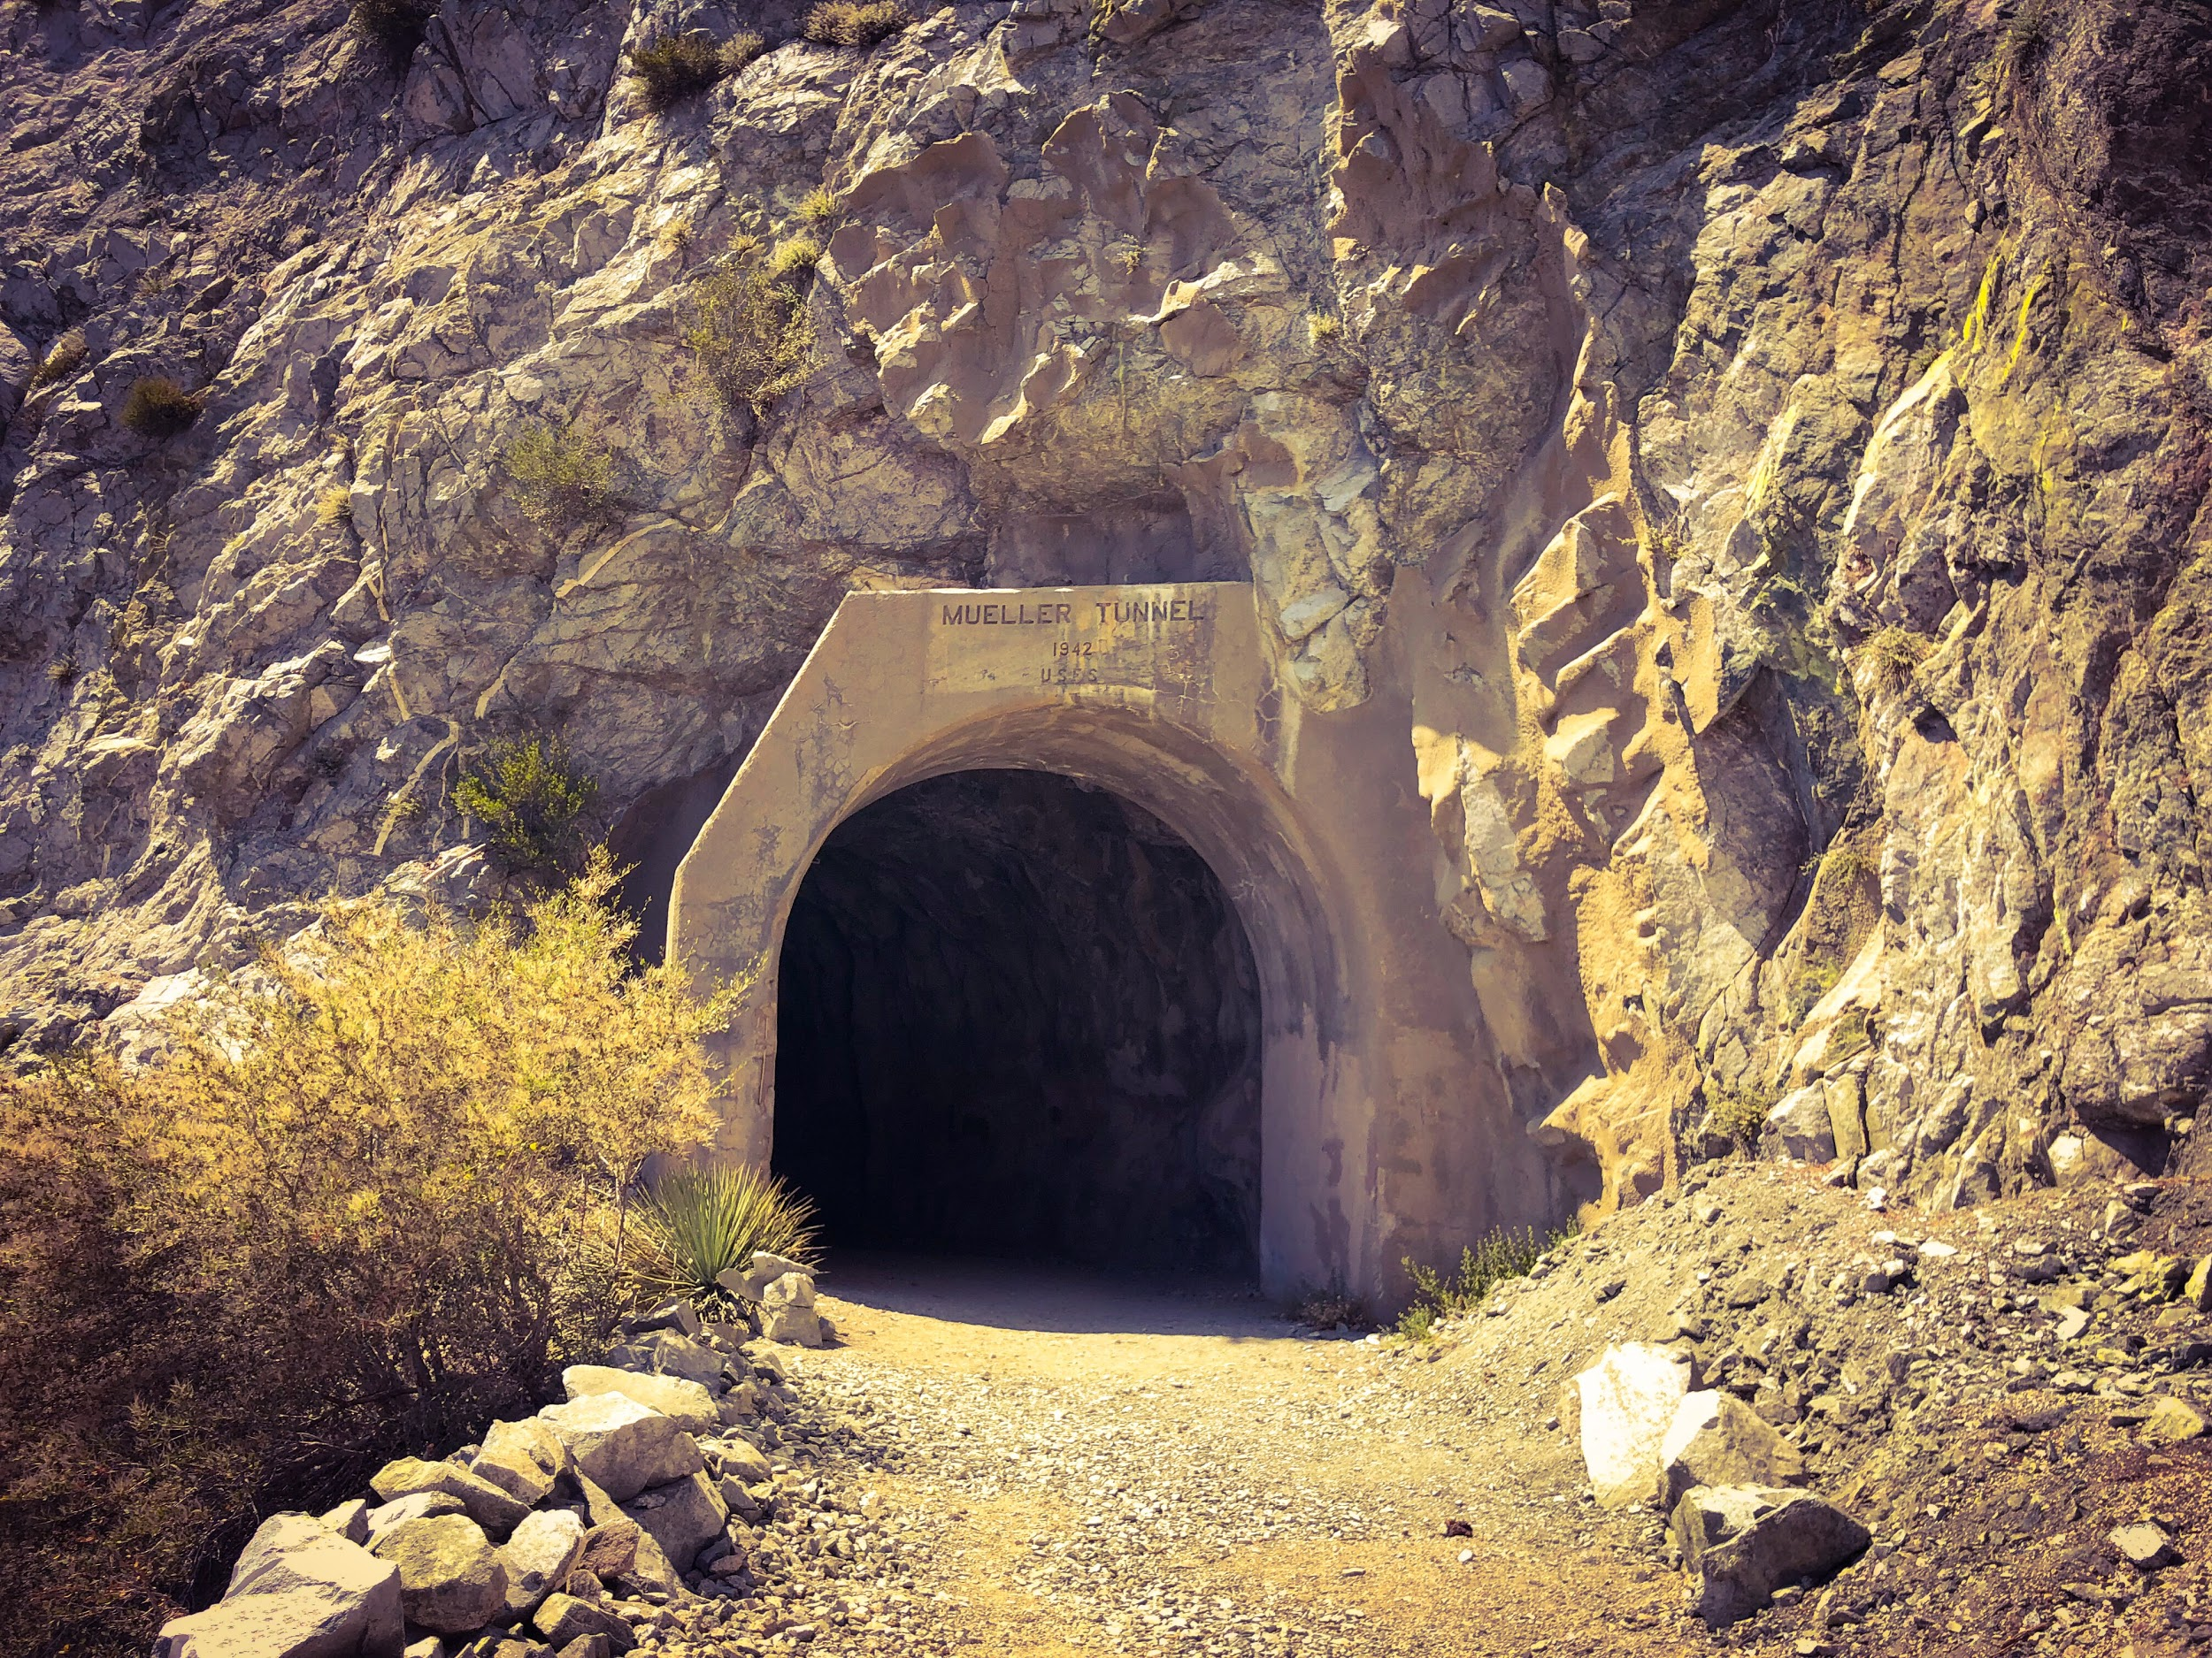
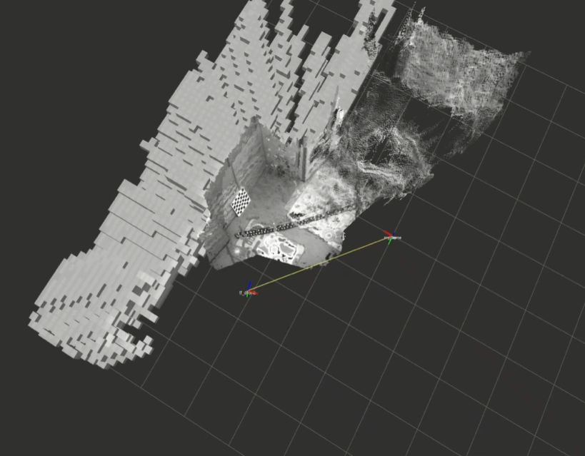
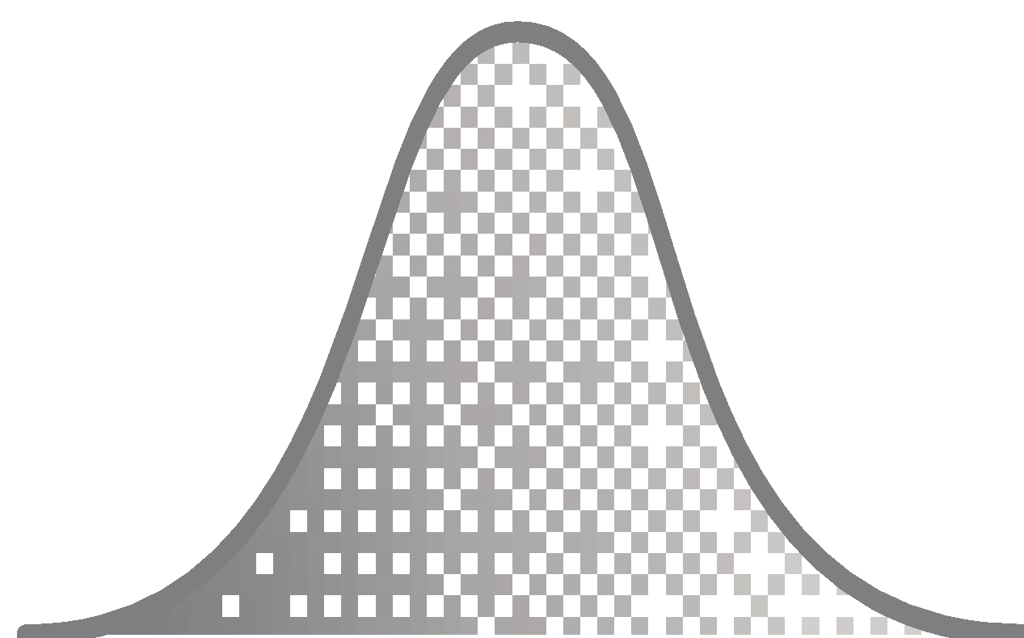
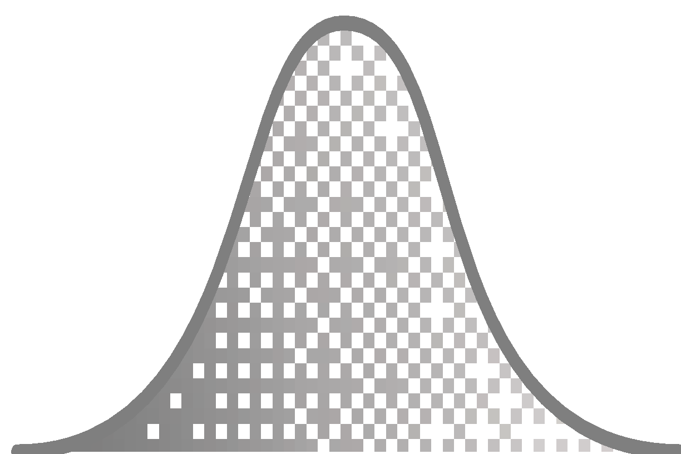
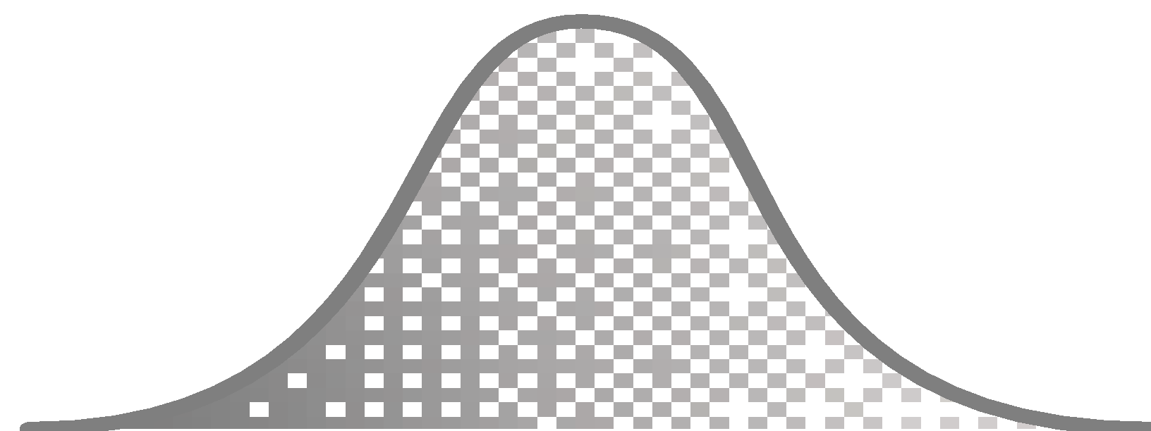
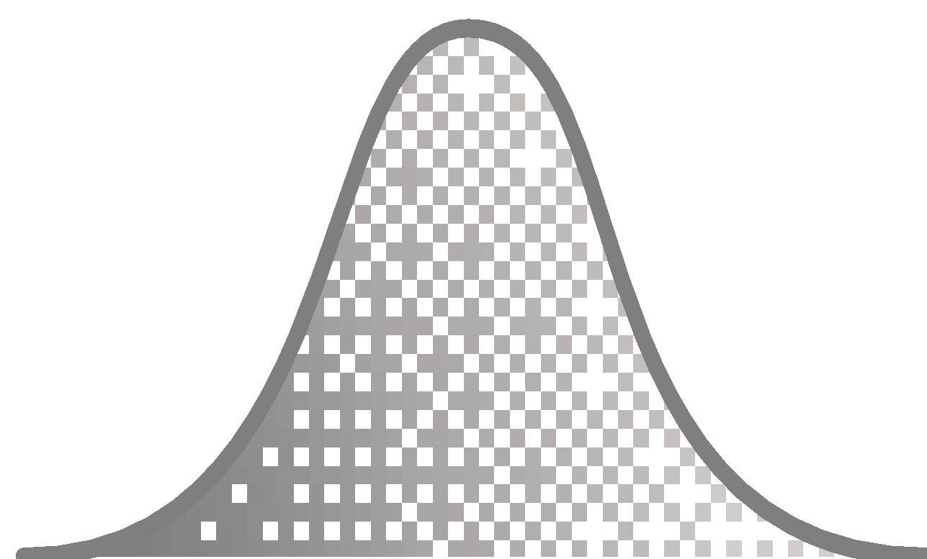
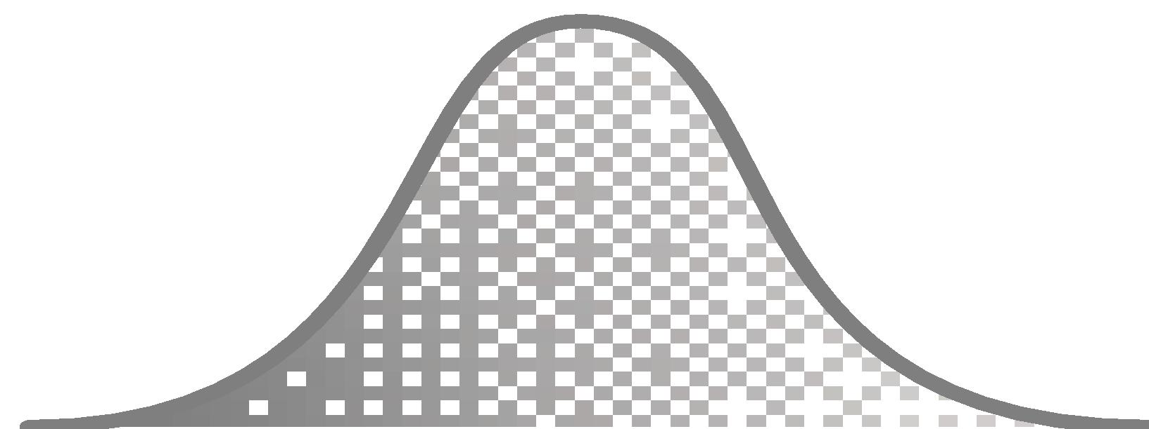
CoSTAR-bots
Collaborative SubTerranean
Autonomous
Resilient robots
Mobility
Long-endurance all-terrain mobility platform.
Localization
Onboard localization + Magneto-quasi-static-based resilient localization system.
Distributed Perception
Robust distributed perception under uncertainty using DGPO.
Communication
Disruption-Tolerant Networking.
Autonomy
Risk-aware belief space autonomy using feedback-based information roadmaps.
Mapping
High-resolution and consistent representation using Confidence-rich grid mapping.
Testing facility: Caltech’s center for Autonomous Systems and Technologies (CAST), JPL’s large Mars Yard, Mueller Tunnel, Bronson/Pisgah/Big-Skylight caves, Galvez tunnel, and potentially abandoned LA railway tunnels.

Slide 13
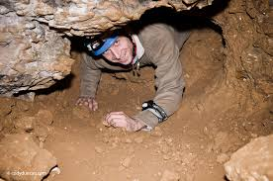
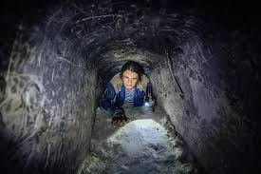
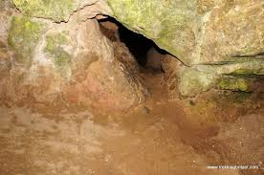
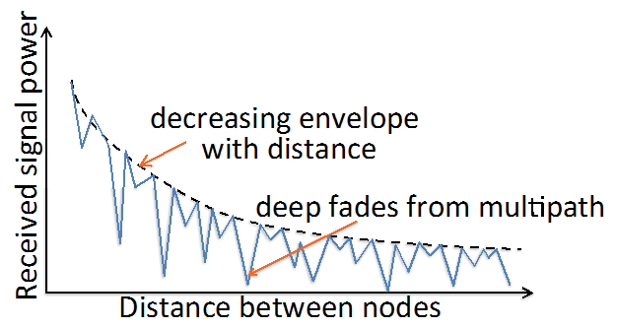
General Challenges in SubT Environments
Mobility
Narrow passages
Climbs and drops
Unpredictable terrain
Dust, debris
Perception
Bandwidth constraints
Darkness/energy constraints
Dust/debris
Perceptual aliasing and high outlier rate
Automated or human-guided recognition?
Localization
No GPS underground
Limited communication between vehicles
Multi-vehicle aspect.

Slide 14
General Challenges in SubT Environments
Communication
Latency constraints
Requires daisy-chain operation
Multipath environment can generate unpredictable link qualities
Rock/soil is poor transmission medium
Need to model, validate, and mitigate uncertainties in data links between nodes in SubT environment
Data drop out

Slide 15
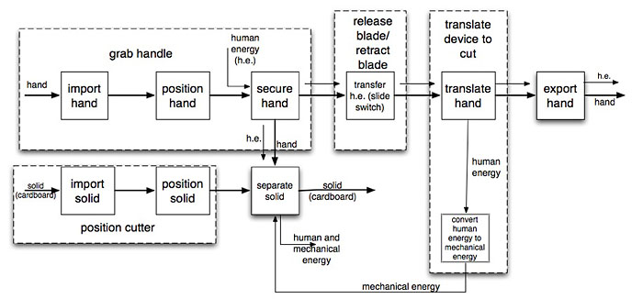
Function Diagram

Slide 16
System Architecture
What is an Architecture:
A model/structure of the system
Properties of the various elements involved in the system
Relationships between the various elements
Behaviors and Dynamics of the various elements
Multiple Views of the system (from energy usage, information usage

Slide 17
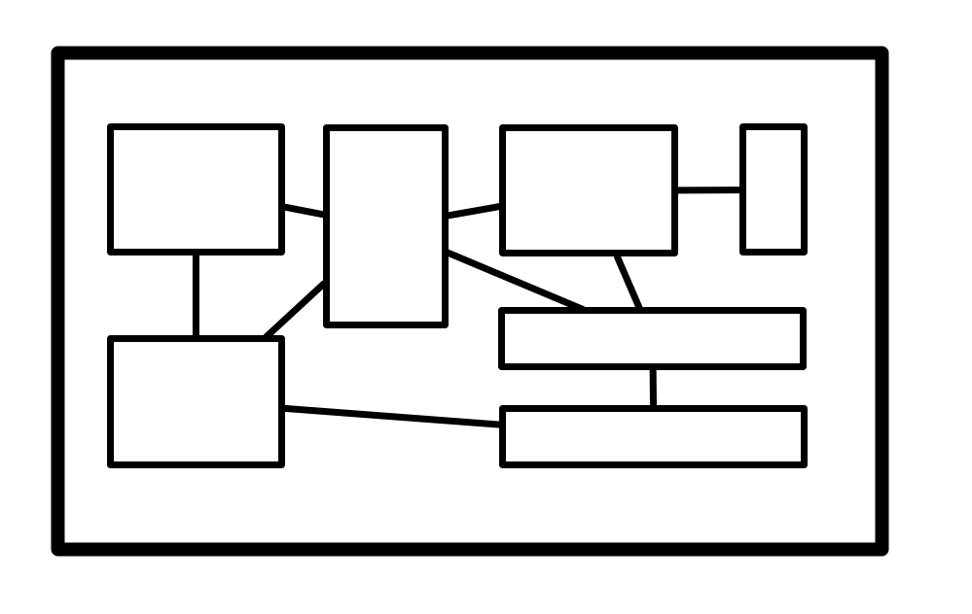
System Architecture
Requirements for an Architecture:
The objects/elements of the system can be modeled (possibly as their own systems)
System can be broken down into small systems (hierarchy)
Can be considered at various levels of abstraction

Slide 18
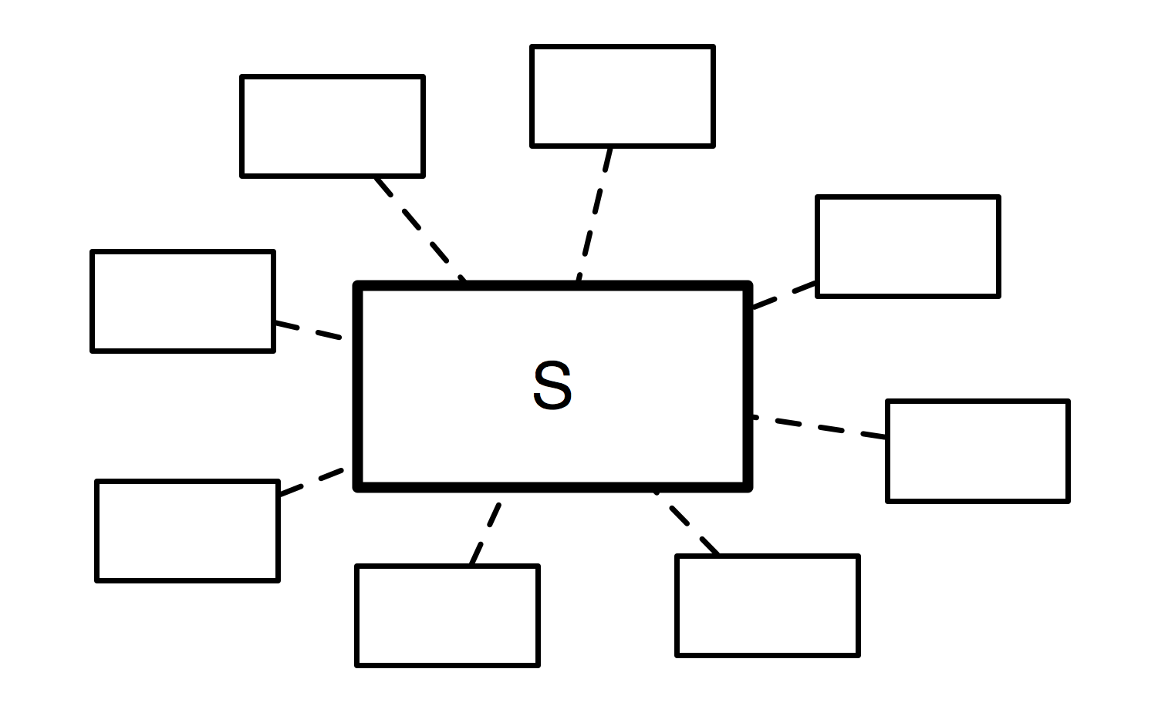
System Architecture
Interactions with environment and other systems
Interfaces between components
Socio-Technical Aspects
Behaviors and Dynamics of the various elements
Multiple Views of the system (from energy usage, information usage

Slide 19
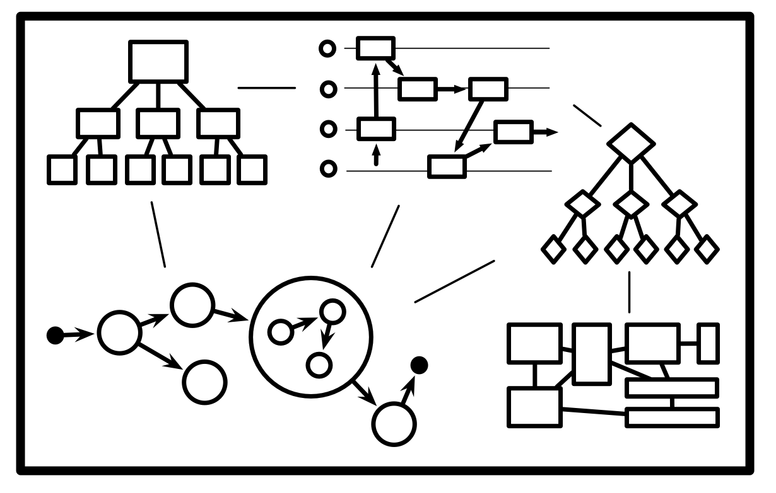
System Architecture
Multiple Views of the system (from energy usage, information usage

Slide 20
Homework
Get an account on GitLab: gitlab.robotics.caltech.edu
Get a slack account
Ask to joint caltechcseeme75.slack.com
Choose a project
Develop an objective tree for your project
Develop a GOTChA chart for your project.

